Slide 1
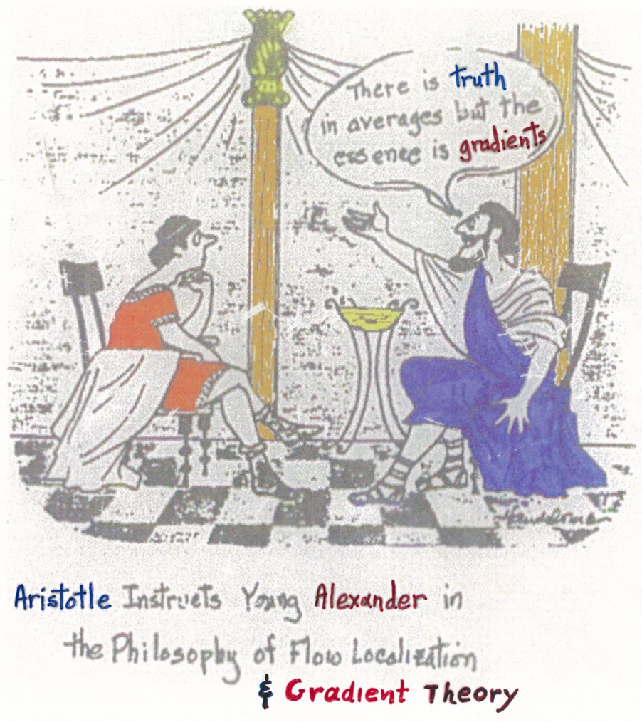
GRADIENT CONTINUUM NANOMECHANICS
[Applications to NCs and UFGs]
Quotation from Richard E. Smalley [American Scientist 85, 324, 1997]
“The Laws of Continuum Mechanics are amazingly robust for treating even intrinsically discrete objects only a few atoms in diameter”
Present Modification of Smalley’s Quotation: Gradient Continuum Mechanics
Slide from Owen Richmond – Lev Pitaevskii
[1990 Int. Conf. on Aristotle’s 2300th Birthday – 50 USSR Participants at Philippion]

Slide 2
Distant Past
Homer’s Automata
  Iliad
  E 749: Hera opens the Gates automatically
  Σ 372: Hephaestus’ 20 golden self-moving tripods
  Σ 468-473: Hephaestus’ automated Lab → modern casting unit?
  Σ 410-420: Young Servant Girls (made out of gold with
  mind/voice/movement) assisting “crippled”
  Hephaestus to walk → human robots?
  Odyssey
  Θ 555-563: Phaeacians’ Ships possessing “mind of their own ” traveling at extremely high speeds at night and in clouds without fear to sink → modern auto-pilots?
}
→ telecontrol?

Slide 3

Recent Past
R. Feynmann (1918-88) Prophet of Nanotechnology
Caltech’s Lecture: Dec 29th 1959
  Recent Examples of New Fields
    Kamerlingh Onnes: Low-Temperature physics
    Percy Bridgman: High-Pressure physics
  New Emerging Field
    Fabricating/manipulating/controlling things on small scale
    In 2000 we will wonder why it was not until 1960 that anybody began seriously moving in this direction
  ∴ Nanoscience / Nanotechnology
“There’s Plenty of Room at the Bottom”

Slide 4

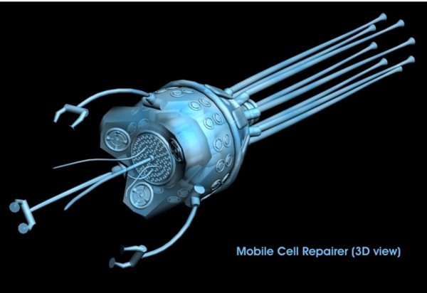
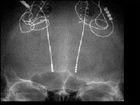
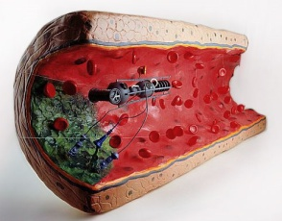
Present – Future
    Cure of Alzheimer’s/Parkinson Diseases and Brain Damage/Paralysis
  Nanostructured Li-batteries / Nanosurgeons
Mobile Cell Repairer
Y. Svidinenko, Nanotechnology News Network
Li-battery
Deep Brain Stimulation
Dr. H. Mayberg, Univ. Toronto
Mobile Artery Cleaner

Slide 5
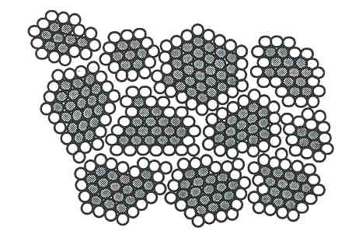
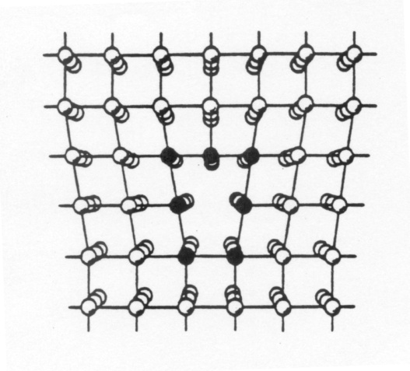
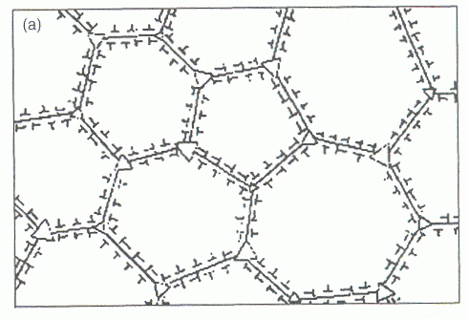
NCs/UFGs: Nanoelasticity/Nanoplasticity/Nanodiffusion
Motivation: Grain Configuration at the Nanoscale
Traditional Polycrystals ……10 – 100 μm
Nanopolycrystals…………….5 – 100 nm
Grain d
1-50 nm
Core r₀
~1 nm
Grain size (d) of the same order as dislocation core (r₀)
10 nm grain size: 30% of atoms in the boundary
Plasticity Mechanisms ? Inverse Hall-Petch Relation ?

Slide 6
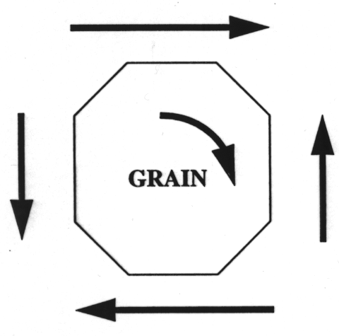
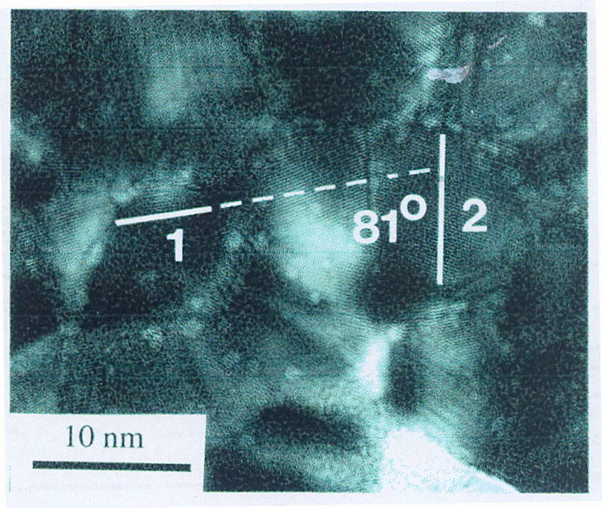
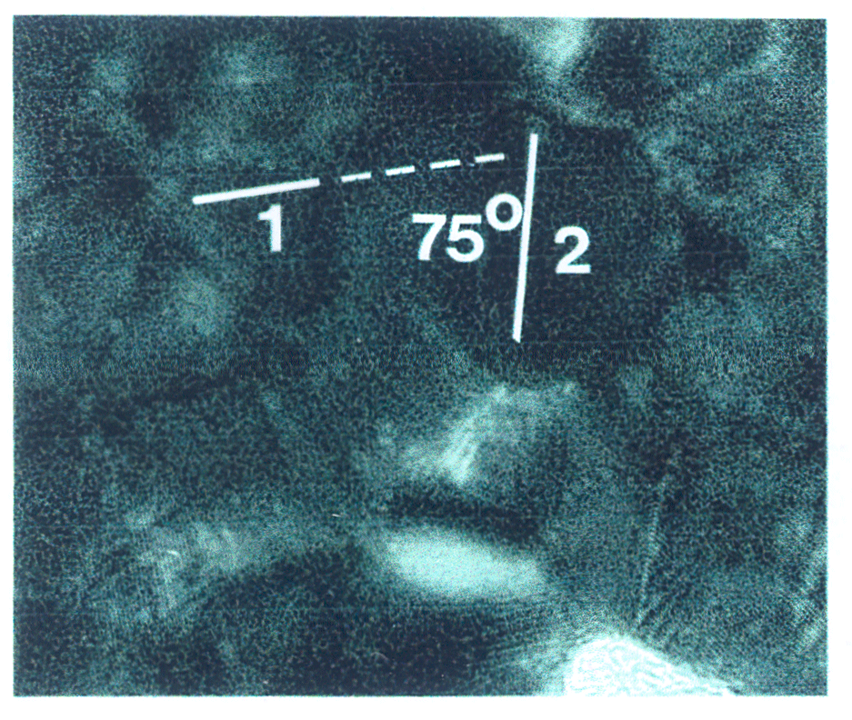
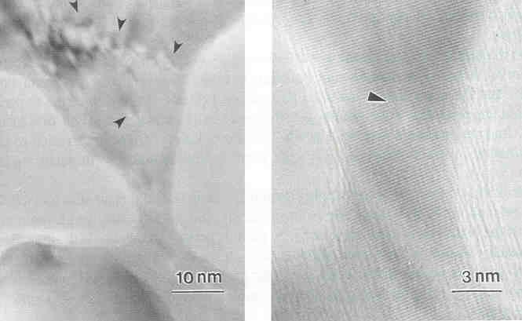
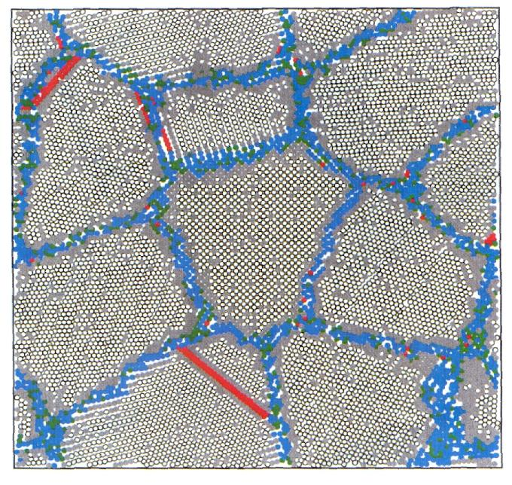
Early MTU Experimental Observations
Grain Boundary Sliding/ Grain Rotation
10 nm Au: 6-15 degrees relative grain rotation due to inhomogeneous GB sliding (unbalanced shear stress)
100 nm Ag film
~12 nm Ni nanopolycrystals

Slide 7
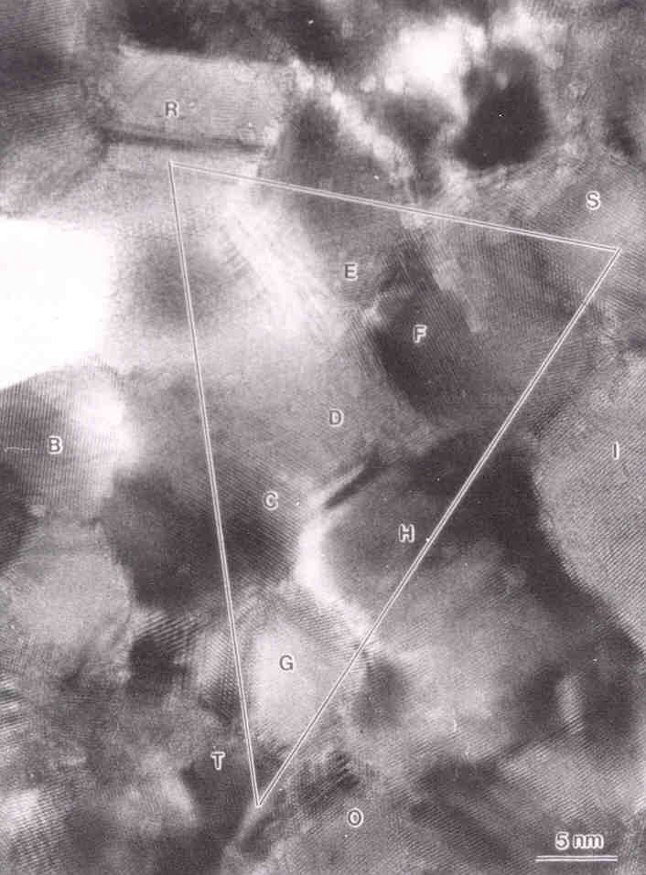
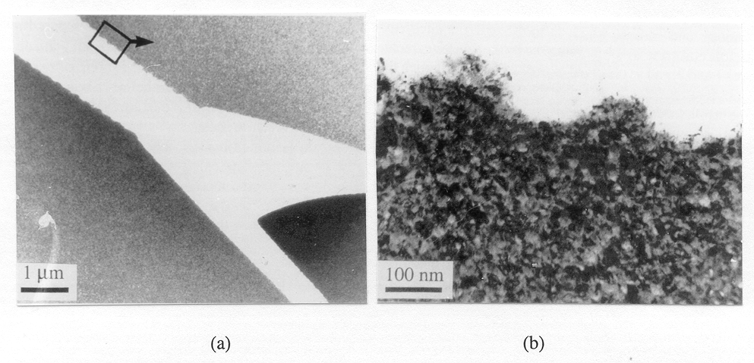
Grain Rotation / Dislocation Emergence
Elementary Rosette Analysis
 | Triangle angles (deg) |  |  | Triangle lengths (nm)
Step | α | β | γ | a | b | c
Start | 89 | 36 | 55 | 22.2 | 27.7 | 16.4
1 | 91 | 35 | 54 | 22.6 | 27.9 | 17.4
2 | 96 | 36 | 48 | 23.4 | 31.2 | 18.9
3 | 102 | 33 | 45 | 21.7 | 32.0 | 18.0
Strain Tensor
Oscillatory Crack Propagation
TEM Strain Rosette
25 nm Au on C: Periodic Crack profiles and bifurcation

Slide 8
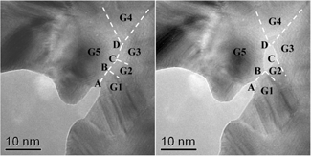
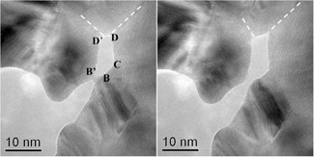
Crack Propagation mechanism: Nanovoid Nucleation at the Tip
8 nm Au on C: Nanocrack growth via nanopore/nanovoid formation/nucleation at triple GB junction
[Wei et al, Science / Scripta Met., 2011/2014]

Slide 9
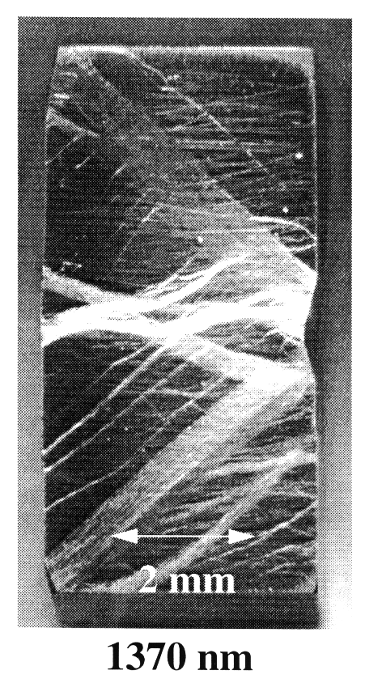
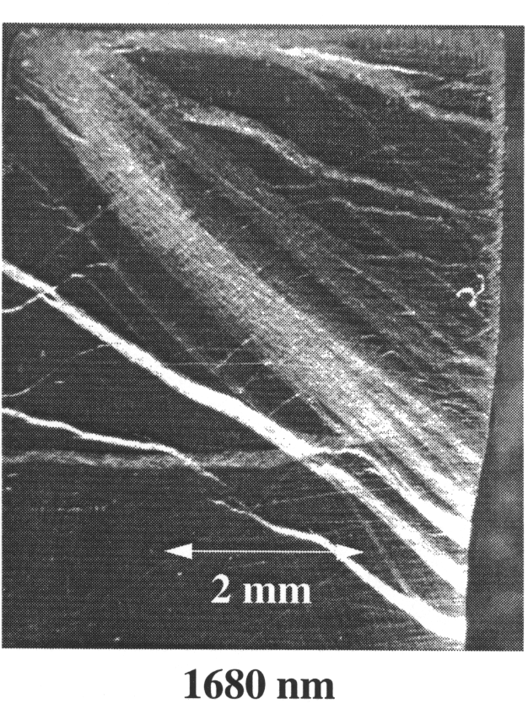
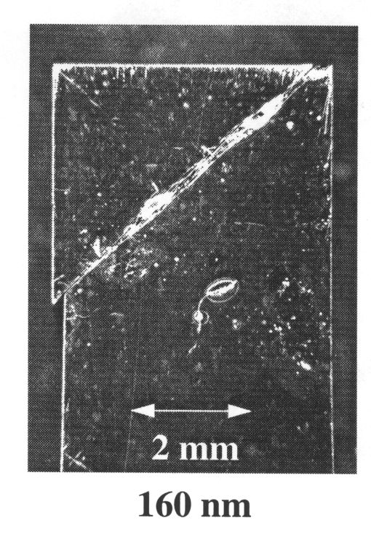
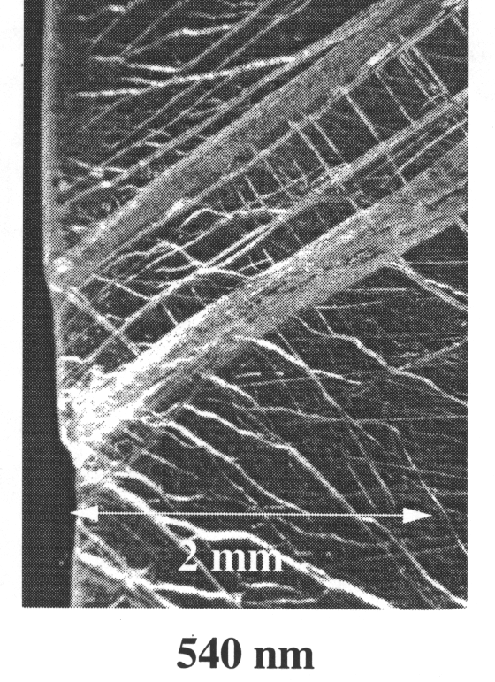
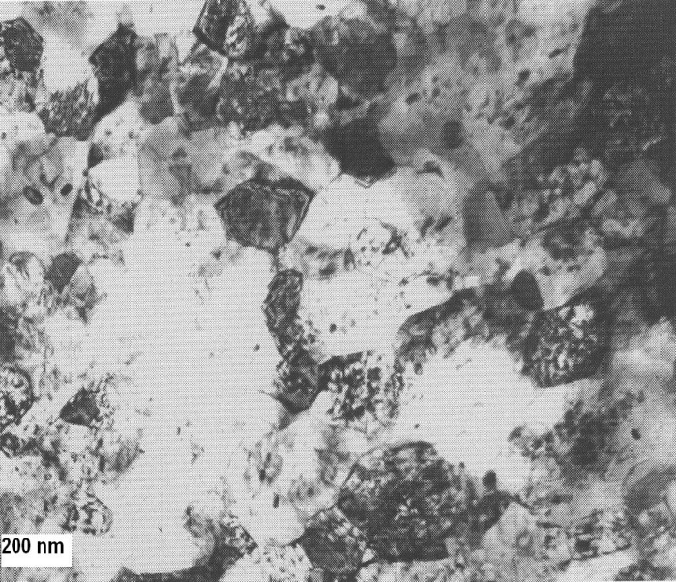
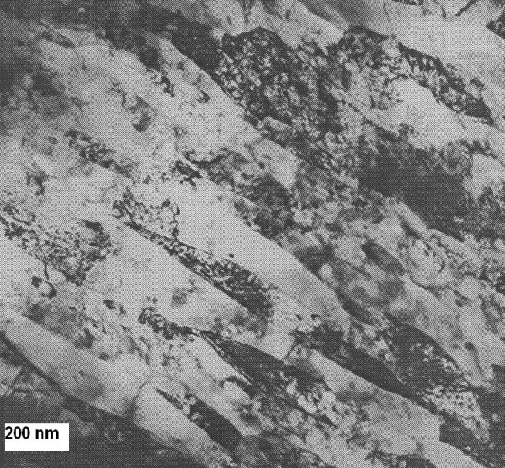
Multiple Shear Banding
Optical micrographs showing deformation and fracture behavior under compression of nanostructured Fe-10% Cu alloy for different grain sizes.
(a)
(b)
TEM micrographs of a compression-tested sample with a 100-nm grain size. (a) Undeformed area outside the shear band region; (b) heavily deformed area in the shear band region.

Slide 10
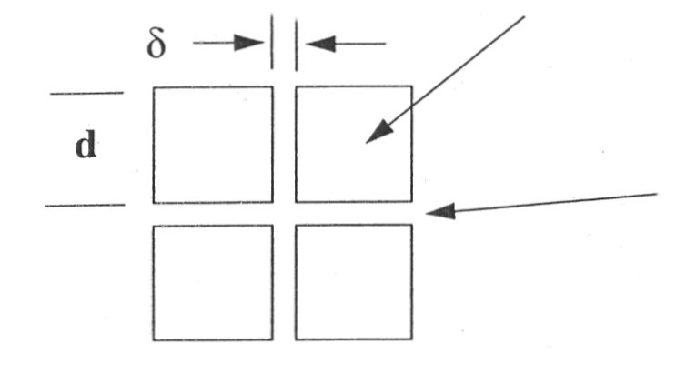
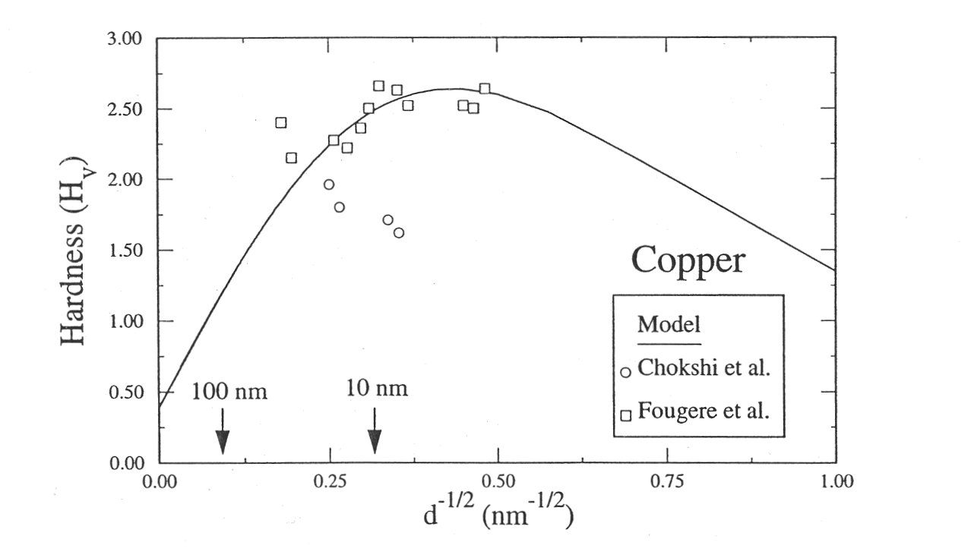
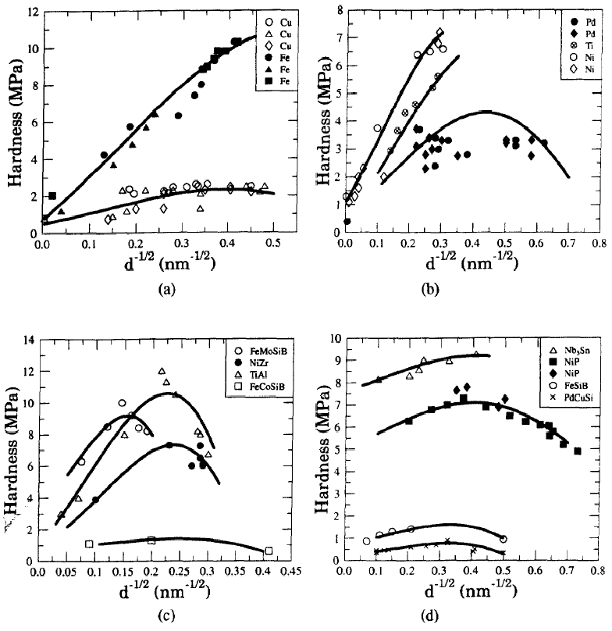
Early MTU Simple-Minded Models
Continuum Two-Phase Model
- Volume Fraction
“Bulk” Phase, Hall – Petch relation
“Boundary” Phase/Amorphous
- Rule of Mixtures
constant strength ( )
Continuum Model predicts behavior of NanoCrystalline Materials
Continuum Model can sort out conflicting Materials Science data
(a) & (b): nanocrystalline metals; (c) & (d): intermetallics

Slide 11
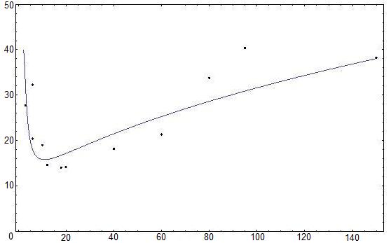
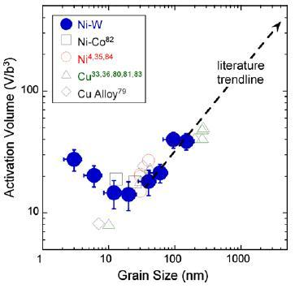
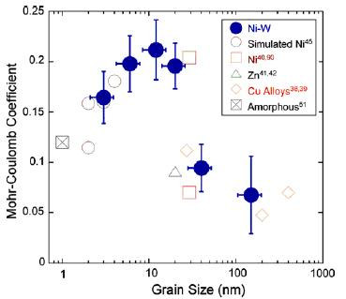
Activation Volume (υ)
Activation Volume
Grain Size (nm)
Grain Size (nm)
Pressure – Sensitivity Parameter (α)
Mohr-Coulomb Coefficient
Mohr-Coulomb Coefficient
Grain Size (nm)
Grain Size (nm)

Slide 12
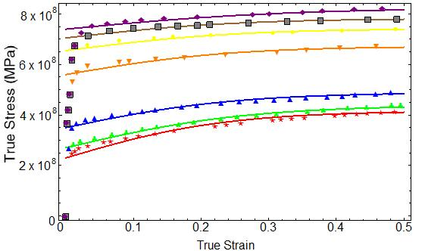
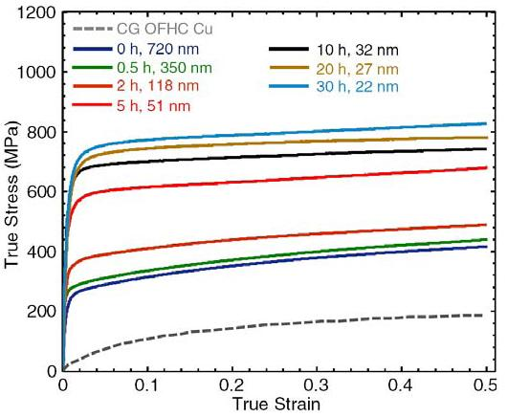
Extension to stress – strain curves
H-P Type Behavior

Slide 13
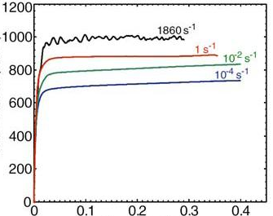
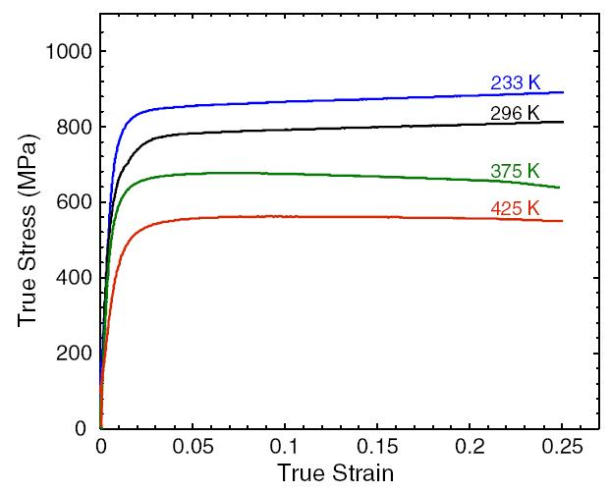
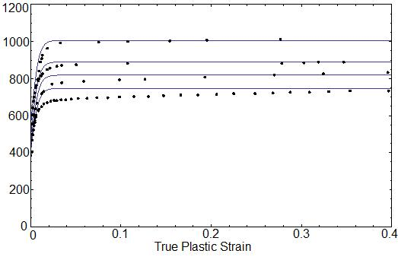
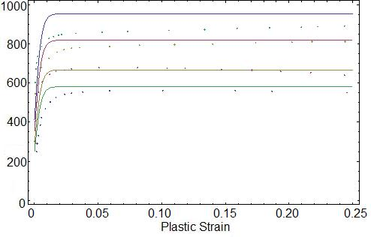
Strain Rate & Temperature Effects
True Stress (MPa)
True Stress (MPa)
True Strain
True Strain
Stress (MPa)
Stress (MPa)
True Plastic Strain
Plastic Strain

Slide 14
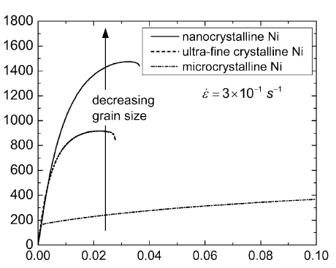
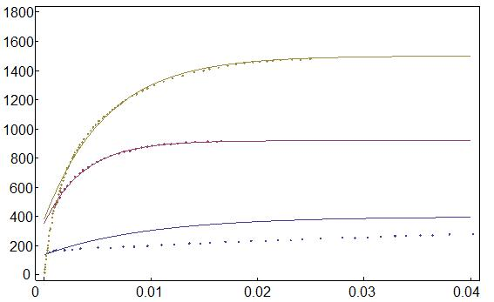
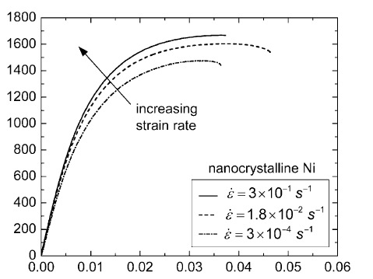
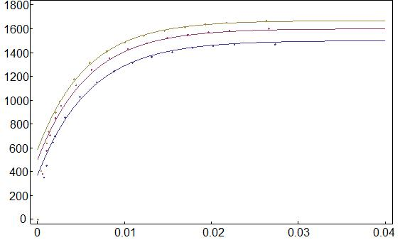
Simultaneous Grain Size & Strain Rate Dependence
Stress (MPa)
Stress (MPa)
Plastic Strain
Strain
Stress (MPa)
Stress (MPa)
Plastic Strain
Strain
386 | 1634 | 0.045 | 437 | 1207 | 0.016 | 60851 | 216646

Slide 15
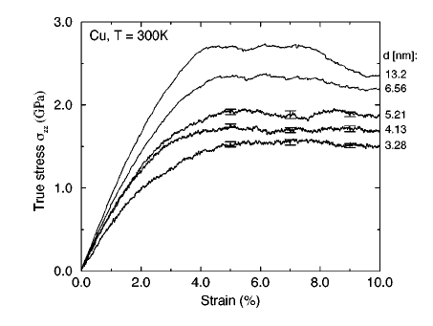
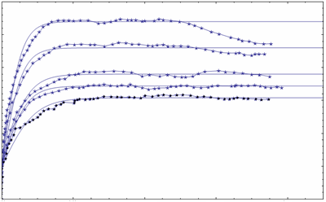
Inverse H-P Type Behavior
3
True Stress (GPa)
2.5
2
1.5
1
Plastic Strain
0.5
0.00
0.02
0.04
0.06
0.08
∴ Continuum Model Compares Well with MD Simulations (Shiotz et al, Phys. Rev., 1999/Science, 2003)

Slide 16
Effective Moduli of Nanopolycrystals
  Idealized Unit Cell
  Average Strain/Effective Modulus
τ∞
h
G_{g}
y
G_{gb}
d
G_{g}
x
h
τ∞
16
h (nm)
h (nm)

Slide 17
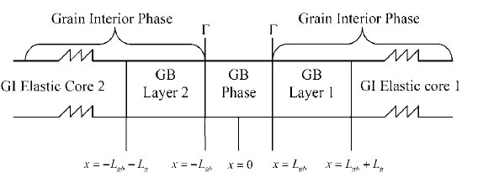
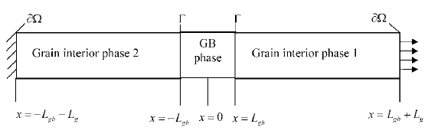
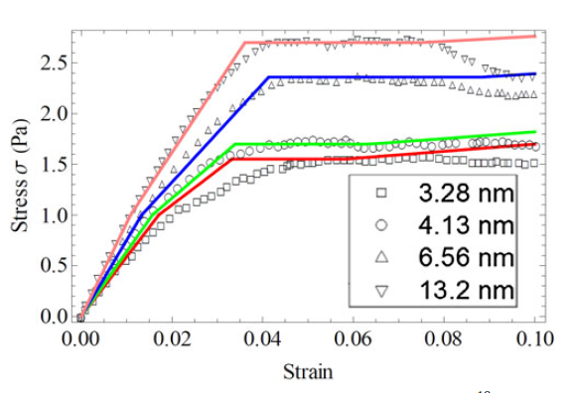
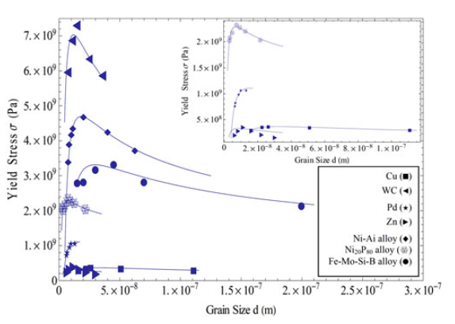
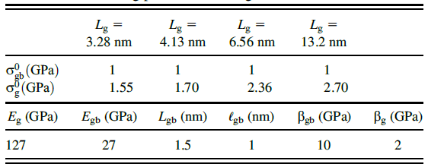
Unit cell model with GB phase, GI phase comprised of GI-GB layers, and elastic GI cores
Unit cell consisting of a GB and a GI phase, for size-dependent stress-strain prediction

Slide 18
I. NANOELASTICITY
[Gradient Elasticity at the Nanoscale]
Nanopolycrystal Elasticity
“Bulk” phase and “boundary” phase
occupy the same material point and
interact via an internal body force
“Bulk” Phase
“Boundary”
Phase
Equilibrium
Elasticity for each phase:
Assume that each phase obeys Hooke’s Law and that the interaction force is proportional to the difference of the individual displacements
Uncoupling

Slide 19
Gradient Elasticity (Gradela)
The above implies the following gradient-elasticity relation
i.e.
elasticity of nanopolycrystals depends on higher – order gradients in strain or the Laplacian of Hookean stress
Ru-Aifantis Theorem
…Gradela solution ;
…classical elasticity solution
Nanocomposites
Another possible configuration to be treated with
Gradela

Slide 20
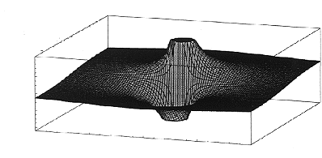
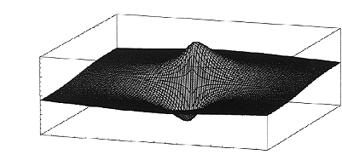
Gradela Dislocation Nanomechanics
Gradela:
Screw Dislocation :
- Stress / Strain :
- Self – energy :

Slide 21
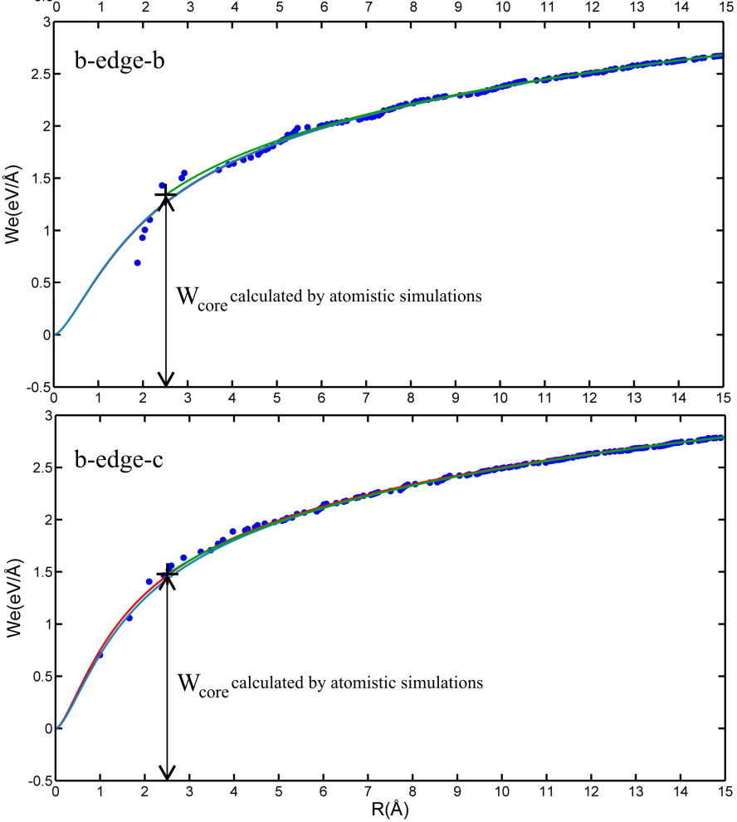
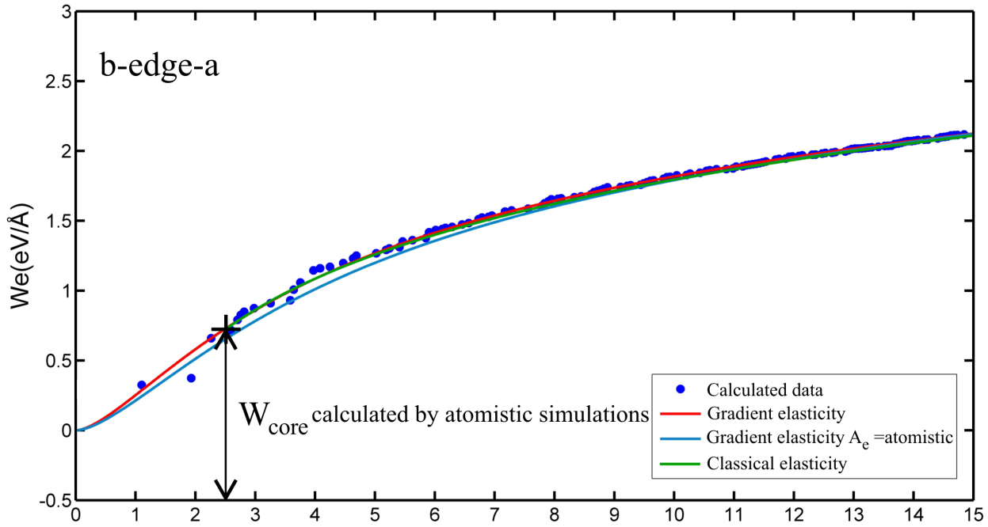
Comparison with MD Simulations (Stilliger – Weber Potential)
W_{core} calculated by atomistic simulations
Atomistic
}
Gradela
W_{core} calculated by atomistic simulations
Elasticity
Invariant Relations:

Slide 22
Image Force – Inverse Hall Petch Behavior
- Self -energy:
- Image Stress:
derived by differentiation and evaluation at (d … grain diameter)
- stress to move a dislocation situated at the center of a grain of diameter d
i.e. critical grain size for inverse Hall-Petch behavior

Slide 23
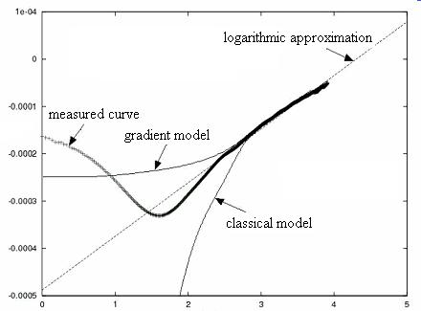
X-ray Line Profile Analysis
- Gradela Soltn for of edge ⊥
log L
- X-ray line profile for deformed Cu single crystal
Intensity I
K - K₀
log L

Slide 24
Gradela Crack Nanomechanics (Mode III)
Gradela: Mode III Cracking
- Gradela:
Target: Non-Singular Stresses/Strain Estimation at the crack tip
- Boundary Conditions
Far field coincidence of stresses:
Vanishing of stresses at the origin:
Zero tractions on crack surfaces:

Slide 25




Nonsingular stress distribution in Mode III
Gradient Stress non-singular
Gradient Stress non-singular
2a
.
.
.
.
Classical Stress singular
Classical Stress singular
Note: max at
∴ (Stress Fracture Criterion)

Slide 26
II. NANOPLASTICITY
[Gradient Plasticity at the Nanoscale]
Motivation from Dislocation Slip
  Momentum Balance for Dislocated State
  Yield Condition:

Slide 27
  Structure of Macroscopic Anisotropic Hardening Plasticity
o
o

Slide 28
  Inhomogeneous Back Stress:
  - = homogeneous back stress … as before
- Integrate over all possible orientations of
  Same Procedure for Nanopolycrystals
- Representative slip plane → Representative planar GB

Slide 29
More on Motivation … Laplacians
Adiabatic Approximation for Defect/Dislocation Density
Non-local Approximation for Strain
▪
▪ Example:
▪
▪
▪ Note: Maxwell’s 1871 Interpretation of the Laplacian

Slide 30


Implications to Localization of Plastic Flow
Constitutive Equation
Linear Stability / SB Orientation
Nonlinear Solution / SB Thickness
γ₀
γ*
γ
Front Propagation
γ₀
γ*
γ
Similar Procedure

Slide 31
Thermodynamics
Thermodynamics applied to gradient theories: The theories of Aifantis and Fleck & Hutchinson and their generalization / JMPS 57, 405-421 (2009)
[M.E. Gurtin/Carnegie-Mellon & L. Anand/MIT]
• Abstract : We discuss the physical nature of flow rules for rate-independent (gradient) plasticity laid down by Aifantis and Fleck and Hutchinson.. As central results we show that:
– The flow rule of Fleck and Hutchinson is incompatible with thermodynamics
unless its nonlocal term is dropped.
– If the theory is augmented by a defect energy dependent on γ^{p} and ∇γ^{p} , then
compatibility with thermodynamics requires that its flow rule reduces to that of Aifantis.
• References : E.C. Aifantis, On the microstructural origin of certain inelastic models, Trans. ASME, J. Engng. Mat. Tech. 106, 326-330 (1984); E.C. Aifantis, The physics of plastic deformation, Int. J. Plasticity 3, 211-247 (1987).
N.A. Fleck and J.W. Hutchinson, A reformulation of strain gradient plasticity, J. Mech. Phys.
Solids 49, 2245-2271 (2001).
M.E. Gurtin, E. Fried, L. Anand, The Mechanics and Thermodynamics of Continua,
Chapter 89 [Gradient Theory of Aifantis], Cambridge University Press (2010).
Aifantis
Fleck and Hutchinson.
Fleck and Hutchinson is incompatible with thermodynamics
unless its nonlocal (gradient) term is dropped.
compatibility with thermodynamics requires that its flow rule reduces to that of Aifantis.

Slide 32


Multiple Shear Banding
- Compression of Bulk Nanostructured Fe – 10% Cu Polycrystals (UFGs)
- Shear band width analysis
d ~1370 nm, σ_{y} ~750 MPa
angle ~ 49⁰
d ~540 nm, σ_{y} ~960 MPa
angle ~ 49⁰
Stress (MPa)
Stress (MPa)
2 mm
Strain
2 mm
Strain
d
Model
Experiment
Grain Size (nm)
o
Self-consistent
Statistics
Shear Band Width (microns)
w

Slide 33

Combined Gradient – Stochastic Model
2D Gradient Deterministic Model
Stochasticity in Yield Stress

Slide 34


- Compression Tests (Milligan, Hackney & Aifantis,2001)
Stress (MPa)
d ~0.5 μm σ_{y} ~880 MPa
2 mm
- Cellular Automata Simulation Results
Strain
σ [Pa]
E=40 GPa
σ_{y} = 800 MPa
a = 0.0014
k=8 GPa
ℓ=50μ
c₁=0.5 N
c₂=30 N
ε [ ]

Slide 35
- More on Nano Shear Bands: n-Fe (Ma et al)
Stress-strain behavior and development of shear bands. Compression test of a Fe sample with an average grain size of 268 nm with loading, unloading, and reloading at various strain levels (~0.3%, 3.7%, and 7.8%).

Slide 36





Serrated Plastic Flow & Multiple Shear Banding
Statistical Aspects of UFGs
(Fan et al. Scripta/Acta Materialia 2005/2006)
σ-ε curves (compression)
High (10⁻² s⁻¹)
Shear Bands (SEM)
Low (10⁻⁴ s⁻¹) – Serrations
Bimodal Grain Size Distribution
UFG matrix: 197 nm
Coarse grains : 3.1 μm (10 %)
Stress Drops time series
Intensity series for Shear Band Distribution
[Remove hardening effect (slope)]
[2D 1D: Space Filling Curve Method (Morton, 1966)]

Slide 37





Serrations
Shear Band Fractality
Tsallis q- Gaussian:
Fractal Dimension
D = 2.3091
Fitting:
vs
log n
Power Law Tail (q>1):
log s
q = 1.29 ± 0.05
Fitting
q = 1.312 ± 0.036
ln_{q}P(s_{i})
Fitting
ln_{q}P(s_{i})
logP(s_{i})
logP(s_{i})
s_{i}
s_{i}
Non-Gaussian Statistics
Tsallis Nonextensive Statistics,
Temporal Long range correlations
Fractal Geometry of Shear Band network
Non-Gaussian Pixels Distributions
Spatial Long range correlations

Slide 38





Shear Band Fractality in Fe – 10% Cu UFG Alloy
(Carsley et al. Metall. Mater. Trans 1998)
Shear Bands
Fractal Dimension
D = 2.72
q = 1.23 ± 0.04
q = 1.23 ± 0.04
log n
ln_{q}P(s_{i})
Fitting
logP(s_{i})
log s
s_{i}
Hierarchical Fractal Shear Band network
No Fractality;
Extreme Fractality
Non-Gaussian Pixels Distributions
Spatial Long range correlations
Gaussian Pixels Distributions
Spatial short range correlations

Slide 39




Shear Band Fractality in Al – 5%Mg - 1.2% Cr ECAP Alloy
Fractal Dimension
D = 2.2171
Fractal Dimension
D = 2.2171
log n
Shear Bands
log s
(Eddahbi et al. J. Matchar. 2012)
q = 1.46 ± 0.08
q_{stat} = 1.46 ± 0.08
ln_{q}P(s_{i})
Fitting
logP(s_{i})
s_{i}
Hierarchical Fractal Shear Band network
Non-Gaussian Pixels Distributions
Spatial Long range correlations

Slide 40
Stochasticity & Serrations in Compressed Micropillars
Dimiduk et al, 2005

Slide 41

Serrated Plastic Flow in Micropillars
- Governing Deterministic Equations
(Zhang and K.E. Aifantis, 2011)
- Serrations
Strain bursts (Δε) are obtained due to the occurrence of discontinuity of the hyperstress between “elastic/no-yielding” and “plastic/yielding” layers
- Introducing Stochasticity

Slide 42
Cellular Automata Simulations
Lattice of 6d×1 cells of size 0.5 μm× d μm (3:1 height to diameter ratio)
Force controlled simulation
Weibull distributed cell yield stress
Intermittent Size-dependent Micropillar Plasticity
d=1 μm: λ=2.5, κ=9
d=2.4 μm: λ=1.2, κ=3
d=10.1 μm: λ=0.75, κ=4
d=39.7 μm: λ=0.4, κ=8
1 μm
1 μm
σ [Pa]
10.1 μm
2.4 μm
σ [Pa]
10.1 μm
39.7 μm
39.7 μm
ε [ ]
ε [ ]
K.E. Aifantis & Konstantinidis, in progress

Slide 43

Random Response of Same Diameter Micropillars
Pillar 1
(Dimiduk et al, 2005)
Pillar 2
Pillar 3
σ [Pa]
Macr. strain
λ =2.8, κ =10
(Bei et al, 2008)
λ =2.4, κ =10
λ =2.4, κ =10
λ =2, κ =8
σ [Pa]
λ =1.5, κ =8
Experiment
Simulation
x
x
ε

Slide 44
Stochasticity Information from Entropy
Boltzmann-Gibbs Entropy
Tsallis Entropy
: entropic index
- Maximum entropy principle leads to q-exponential distribution
- Generalization
(instead of
as commonly done)
Note: Using the Tsallis entropy formulation the “events” with
high probability but low intensity are not ignored, as is the
case with power-law formulations

Slide 45
Extracting Information on Randomness / PDF
Probability of bursts of size s
Burst size relation to local yield stress
(L: cell size)
Probability of bursts from n “sites”
∴

Slide 46

Strain bursts in Mo micropillars under compression
(Zaiser et al, 2010)
p(s)
I ≡ s (strain burst)
Λ= -1.5
Burst size s [nm]
CA simulations with input from q-statistics
x
x
experiment
simulation
d= 166 nm
d = 192 nm
d = 393 nm
d = 435 nm
d = 435 nm

Slide 47
Micropillar Compression CA Simulations
- Constitutive relation
- Avalanche probability distribution
- Avalanche size distributions for varying
∴

Slide 48



PLC Effect in Al-2.5%Mg Alloy
- Chatterjee et al, 2010
- Tsallis q-Statistics

Slide 49
III. NANODIFFUSION
[Gradient Diffusion at the Nanoscale]
  Double Diffusivity / Diffusion in Nanopolycrystals
Simplest Model
Solution

Slide 50


Uncoupling / Higher-order Diffusion Equation
Observations / Experiments
- Grain boundary space

Slide 51




Diffusion Penetration Profiles
Concentration (arb. units)
Specific activity (arb. units)
x^{6/5} (10⁵ m^{6/5})
x² (10⁴ nm²)
C
x [μm]

Slide 52




More Recent Data: Divinski et al 2009, 2010
⁶³Ni in UFG Cu & cg Cu
⁸⁶Rb in UFG Cu
^{110m}Ag, ⁶⁵Zn, ⁵⁹Fe in UFG Cu-1wt%Pb
⁶³Ni in UFG Cu-1wt%Pb
^{110m}Ag in ECAP Cu &ECAP+bp Cu
⁶³Ni in ECAP Cu & HPT Cu

Slide 53
IV. NANOCHEMOELASTICITY
[Gradient Chemoelasticity at the Nanoscale]
  Concentration/Mass Balance
c … concentration of chemical species; …flux
  Stress/Force Balance
T … stress
  Free Energy
…infinitesimal chemostrain tensor
M…lattice mismatch tensor of the two phases;

Slide 54
  Spinodal Decomposition Governing PDEs
– Spinodal gap → homogeneous concentrations become linearly unstable
–
…displacement satisfying kinematic PDEs when
– Finite 1D System:
Uniform concentrations are unstable when

Slide 55
  Constitutive Equations
– Stress
– Flux
– Free Energy

Slide 56
  Illustrative Example: Regular Solution Model
…a reference value of the chemical potential
R…universal gas constant, …absolute temperature
is non-convex with two cells → spinodal decomposition
∴ Size Effects on Spinodal Gap Width

Slide 57

  Size – dependent Spinodal Gap Width
Size effect on the spinodal gap width for different values of the internal lengths ratio β
• Spinodal range is more narrow as the specimen size decreases
• For sufficiently small values of L there is no spinodal region at all
•

Slide 58
V. NANO DEFECT KINETICS
[Gradient Defect Kinetics at the Nanoscale]
The W–A Model:
Application to Nanopolycrystals
ρ – mobile dislocations in the grain interior
φ – low-mobility (immobile) dislocations (dipoles)
ϑ – immobile junction disclinations
ψ – grain boundary sliding dislocations

Slide 59
Twinning in Nanopolycrystals
ρ – mobile dislocations
θ – disclination dipoles (twin fronts)
φ – twin lamellae
ξ – sessile Lomer-Cotrell dislocations

