Slide 1
Μοντέλα ΑDMET

Slide 2
Molinspiration
www.molinspiration.com

Slide 3
1

Slide 4
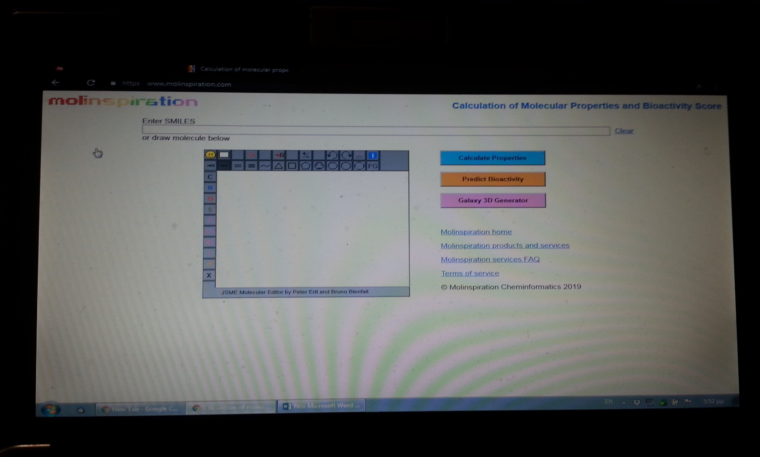
2

Slide 5
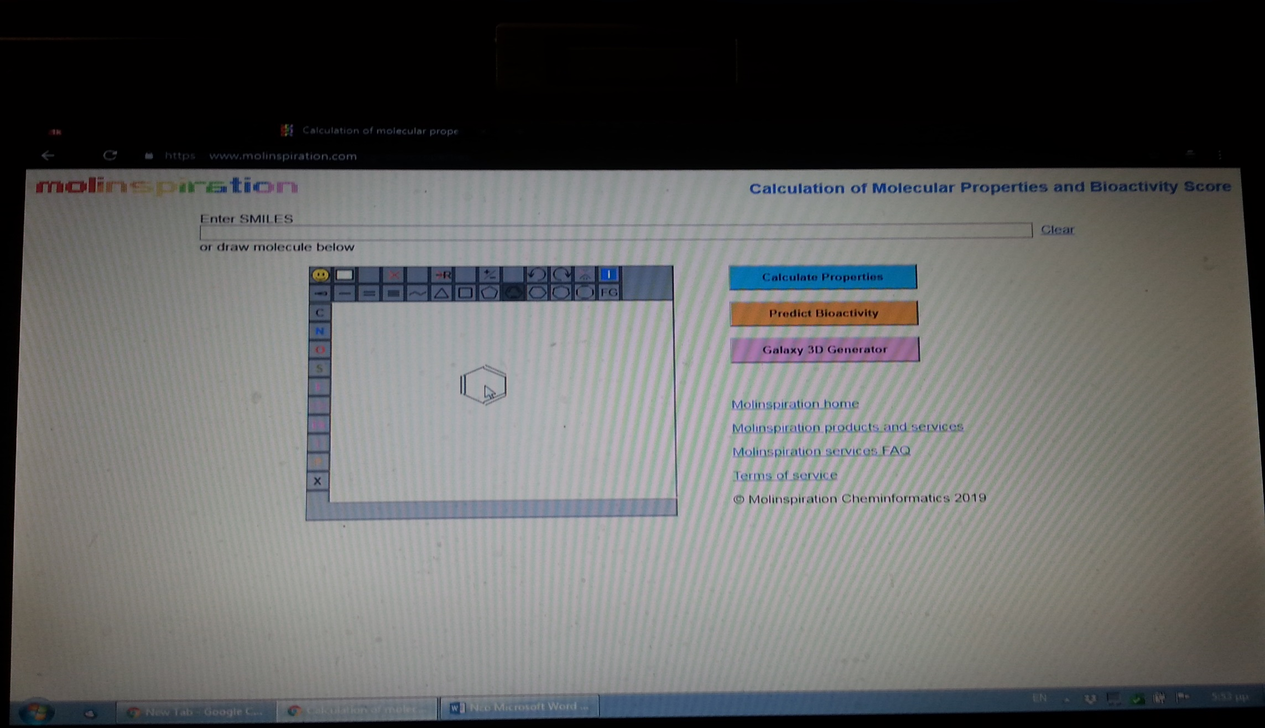
3

Slide 6
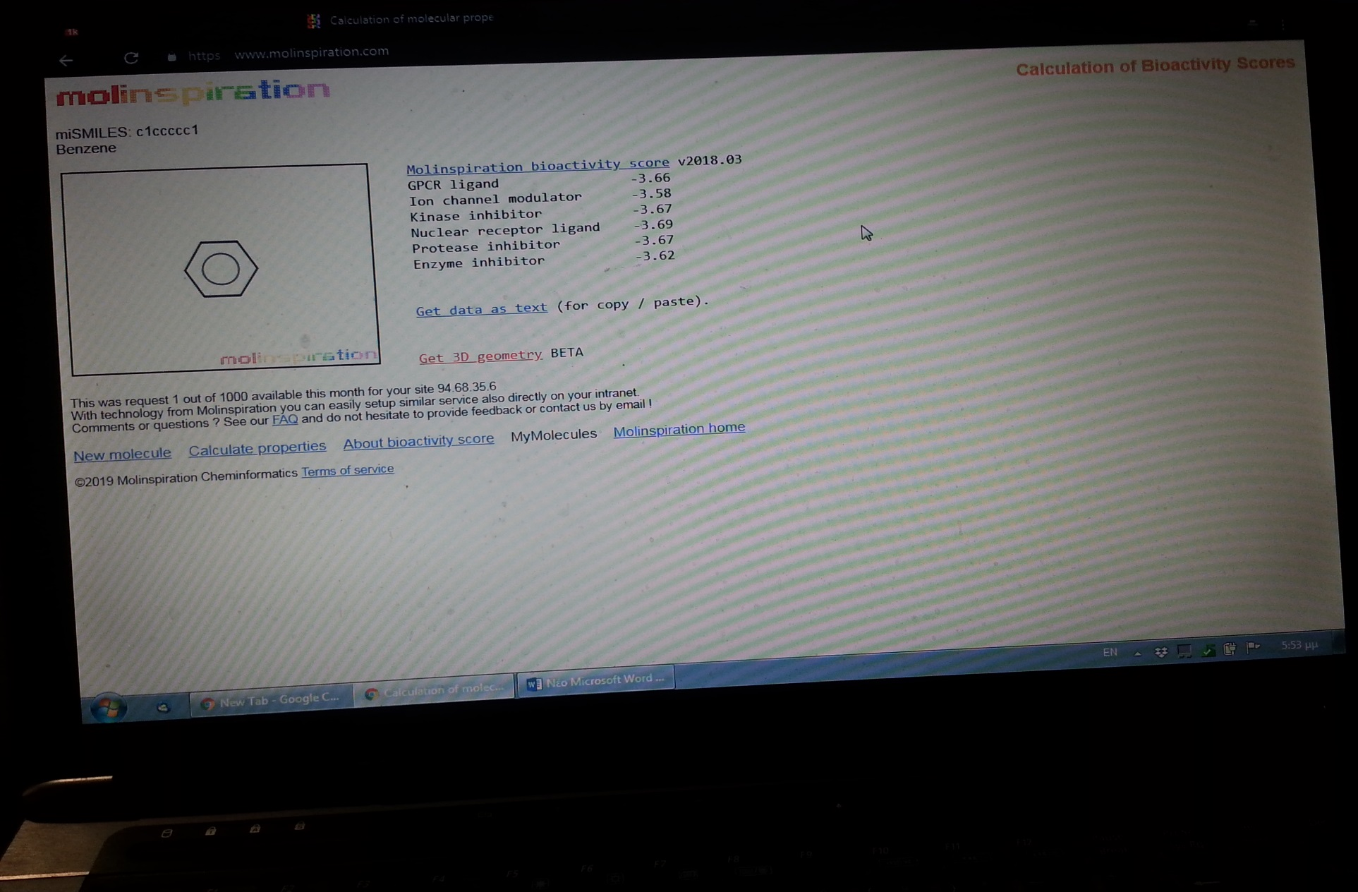
4

Slide 7
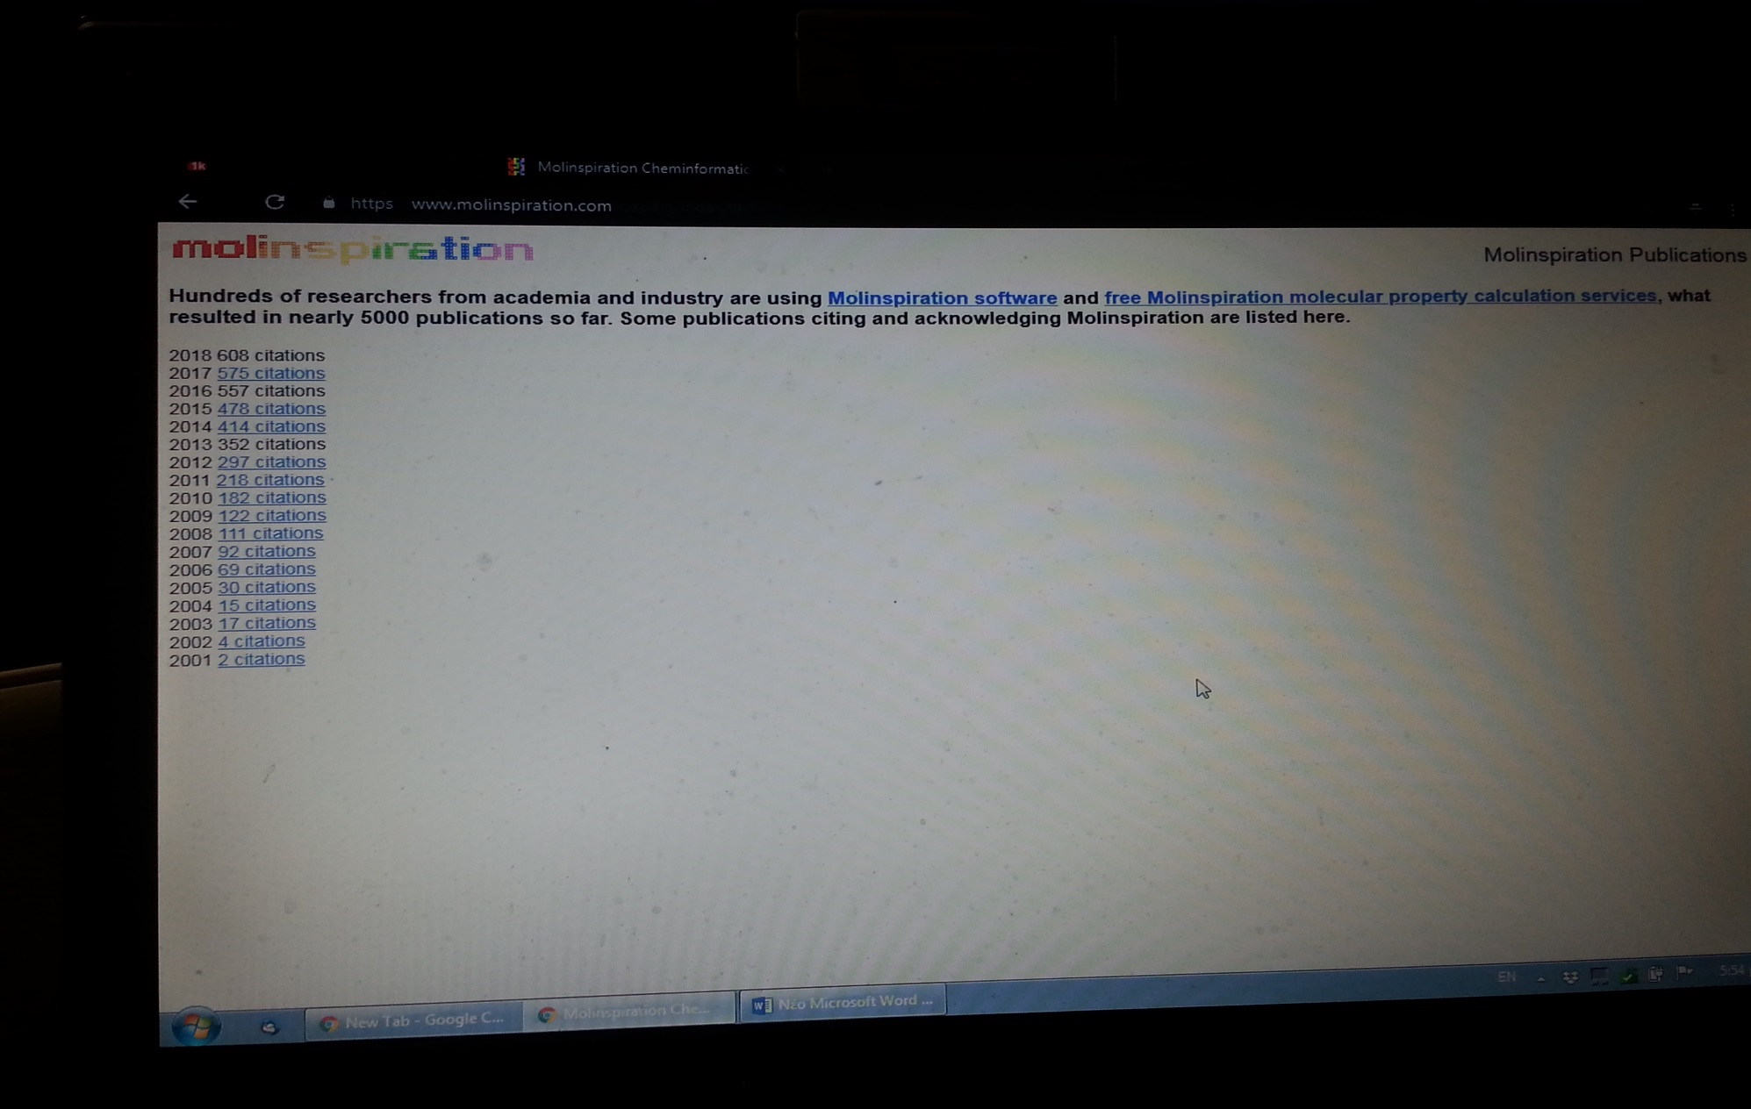
4

Slide 8
Molecular Properties Prediction—Lipinski “Rule of Five”
poor absorption or permeation is more likely when:
there are more than five H-bond donors,
10 H-bond acceptors,
the molecular weight (MW) is greater than 500,
Rotated bonds >10 and
the calculated Log P is greater than 5
LogBB (BB, Blood Brain Barrier) is another important in silico parameter to identify CNS active agents
For in silico prediction, compound with logBB value more than 0.3 is considered to have high absorption through BBB whereas between 0.3–0.1 and less than −0.1 is considered to be moderate and less absorbed through BBB
molecules with less than 500, could be easily transported, diffused, and absorbed in comparison to large molecules

Slide 9
Topological polar surface TPSA
Topological polar surface area is highly correlated with the hydrogen bonding of a compound.
It is used as a significant indicator of the bioavailability of a bioactive molecule.
TPSA below the limit of 160 Å² indicating good oral bioavailability.
The upper limit for TPSA for a molecule to penetrate the brain is around 90 Å².
logBB = 0,155ClogP – 0,01TPSA + 0,164
logBB= 0,152ClogP – 0,0148TPSA + 0,139

Slide 10
www.in silico.de
In silico toxicology
Webfree interface
1. παράθυρο σχεδιασμού της δομής
2. Acute toxicity (επιλέγουμε ένα)
ΒΒΒ
Human
Rat
Carcinogenicity
Mutagenicity
3. Predict

Slide 11
preadmet.bmdrc.kr
Druglikeness
ADME prediction
toxicity

