Slide 1
Humanities & Social Sciences

Slide 2
Frankfurter Schule, school of social theory and philosophy [Frankfurt School] (Goethe University Frankfurt).
Herbert Marcuse
Theodor Adorno
Max Horkheimer
Walter Benjamin
Erich Fromm
Friedrich Pollock
Leo Löwenthal
Jürgen Habermas
Alfred Schmidt
Axel Honneth
Siegfried Kracauer

Slide 3
Frankfurt School
Critical theory
Dialectic
Praxis
Psychoanalysis
Antipositivism
Popular culture
Culture industry
Advanced capitalism
Privatism
Non-identity
Communicative rationality
Legitimation crisis

Slide 4
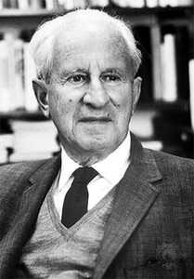
Frankfurt School, Herbert Marcuse, 1898-1979
the New Left,
the subjectivity of the
individual, expanded Marx’s
Alienation (capitalism exploits
humans, and by producing
objects the laborers become
alienated, dehumanized to
functional objects), capitalism
pushed laborers to see themselves
as extensions of the objects they were
producing.

Slide 5
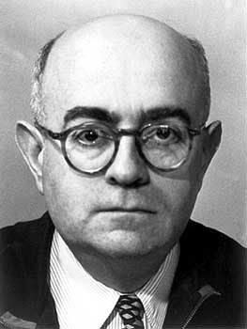
Frankfurt School, Theodor Adorno, 1903-1969
Critical Theory, automatic system, society is a self-regulating system, from which one must escape (but from which nobody can escape). Standardization, the products of capitalist-driven mass media and mass culture in pursuit of maximum profit. A media culture driven society, its main characteristics is product consumption.

Slide 6
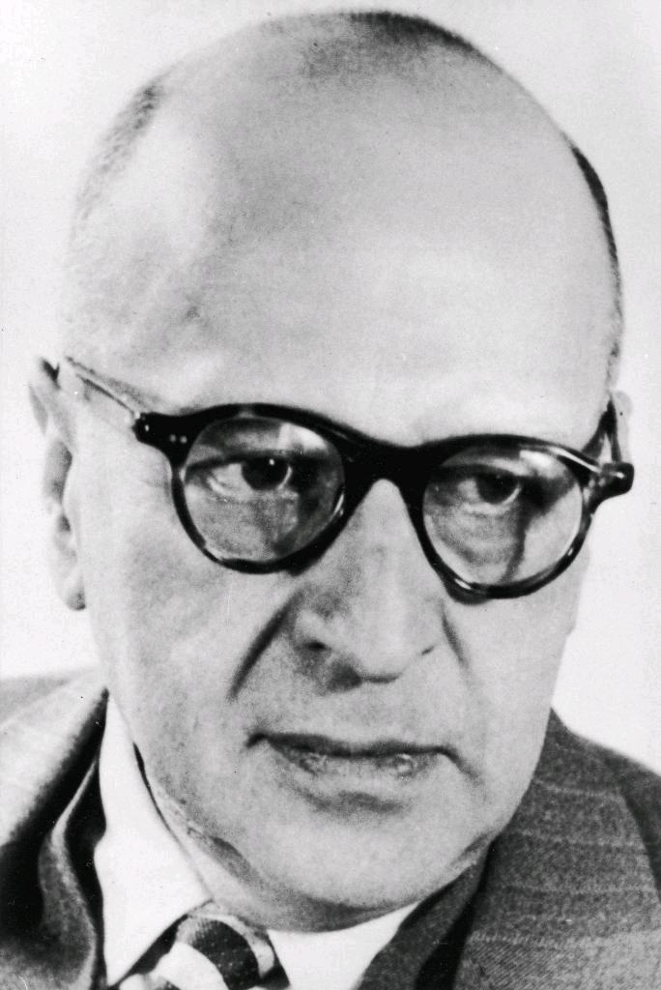
Frankfurt School, Max Horkheimer, 1895-1973
Authoritarianism, militarism, economic disruption, environmental crisis, and the poverty of mass culture using the philosophy of history as a framework.

Slide 7
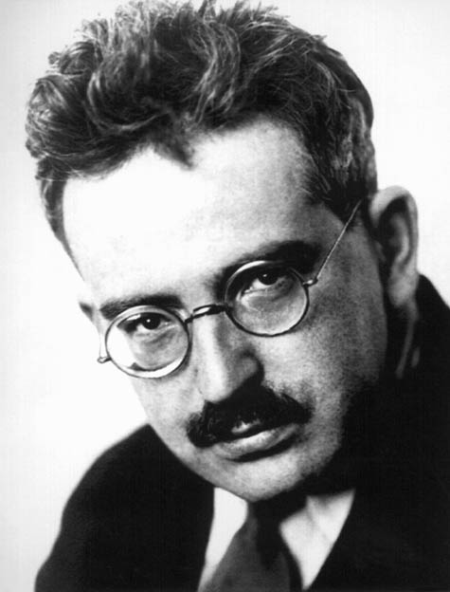
Frankfurt School, Walter Benjamin, 1892-1940
Aesthetic theory, literary criticism, and historical materialism.

Slide 8
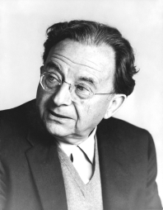
Frankfurt School, Erich Fromm, 1900 -1980
Social psychologist, sociologist.
Social and political philosophy,
in favor of a humanistic and
democratic socialism. Early
works of Karl Marx (the ideal of
freedom), reject dehumanizing
Western capitalism and Soviet
communism, which resulted in
the phenomenon of alienation.

Slide 9
Wolfgang Abendroth, 1906-1985

Slide 10
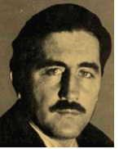
Karl Korsch, 1886-1961
Western Marxism in the 1920s

Slide 11
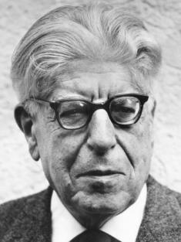
Ernst Bloch, 1885-1977
Marxist philosophy, in a humanistic world, where oppression and exploitation have been eliminated, there will always be a truly revolutionary force. 1961 Tübingen.

Slide 12
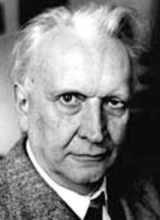
Karl Jaspers, 1883-1969
Psychiatrist, philosopher with a strong influence on modern theology, exponent of existentialism.

Slide 13
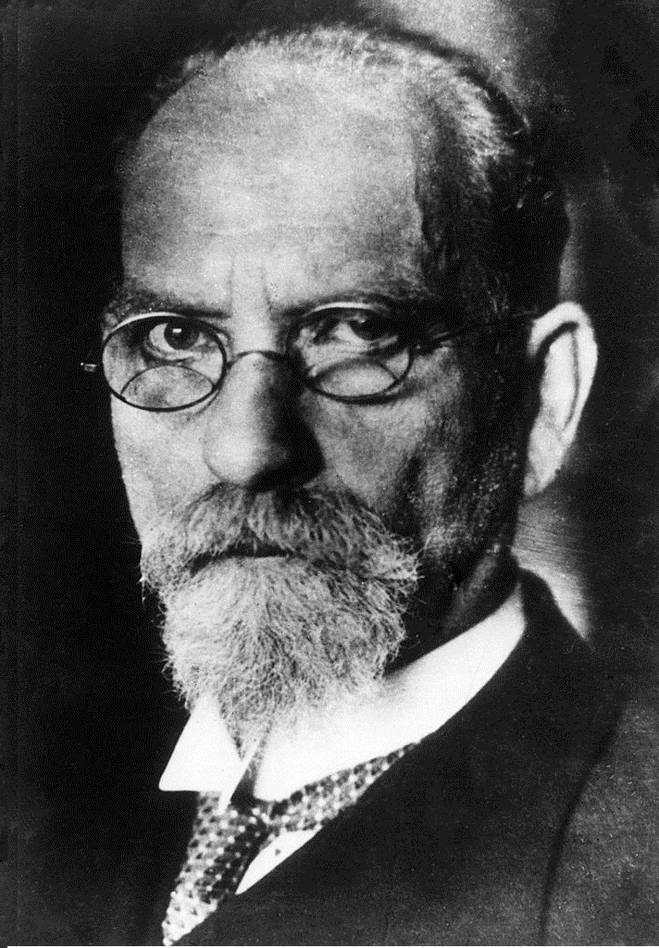
Edmund Husserl, 1859-1938
Phenomenology, the systematic study of the structures of consciousness and the phenomena that appear in acts of consciousness. Differentiated from the Cartesian method of analysis (the world is objects, sets of objects, and objects acting and reacting upon one another).

Slide 14
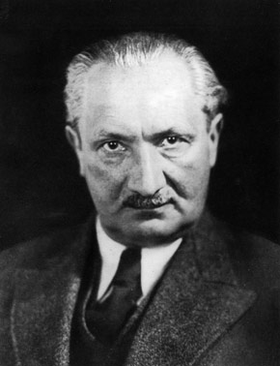
Martin Heidegger, 1889-1976
Being, time, and Dasein

Slide 15
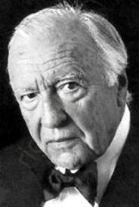
Hans-Georg Gadamer, 1900-2002

Slide 16
Philosophers of science

Slide 17
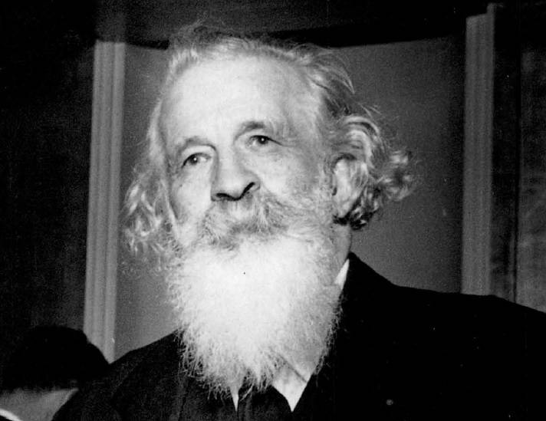
Philosophers of science, Gaston Bachelard, 1884-1962

Slide 18
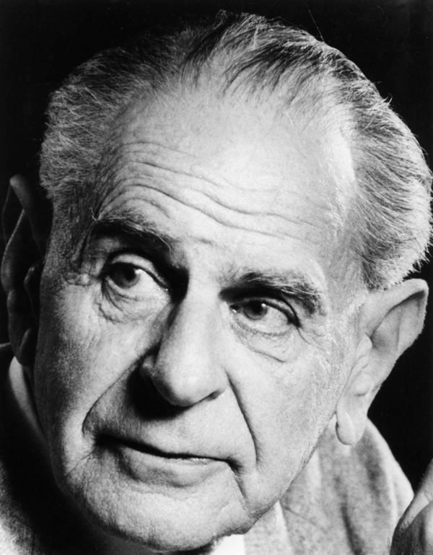
philosophers of science, Karl Popper, 1902-1994

Slide 19
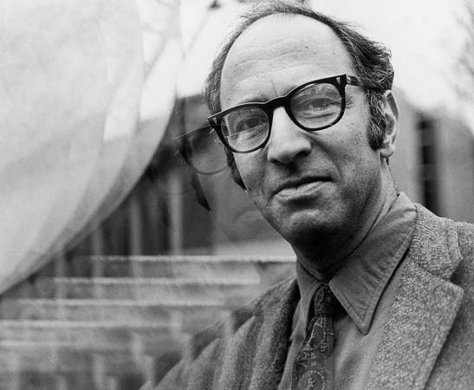
Philosophers of science, Thomas Kuhn, 1922-1996

Slide 20
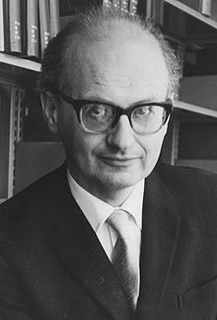
Philosophers of science, Imre Lakatos, 1922-1974
«Η ιστορία της επιστήμης
χωρίς τη φιλοσοφία της
επιστήμης είναι τυφλή»
[σχέση μεταξύ
επαναστατικής θεωρίας
και πράξης].

Slide 21
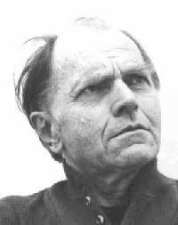
Philosophers of science, Paul Feyerabend, 1924-1994

Slide 22
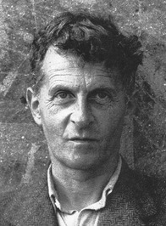
Ludwig Wittgenstein, 1889-1951

Slide 23
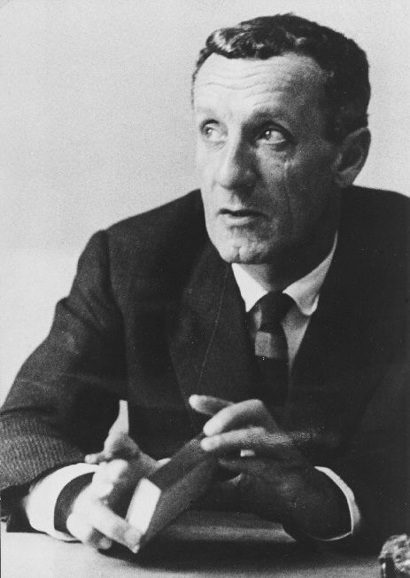
Maurice Merleau-Ponty, 1908-1961

Slide 24
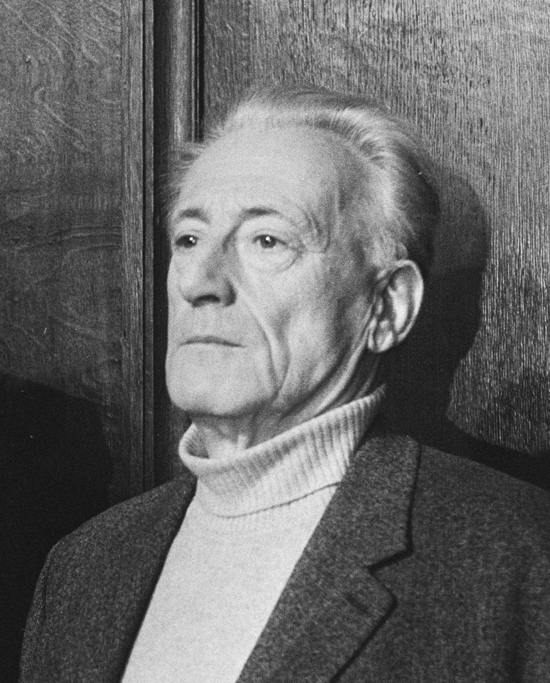
Henri Lefebvre, 1901-1991

Slide 25
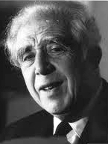
Georges Friedmann, 1902-1977

Slide 26
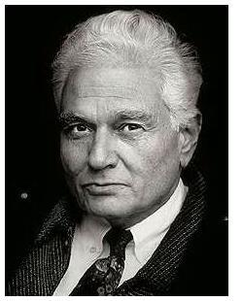
Jacques Derrida, 1930-2004
Déconstruire le
« logocentrisme »
(le primat de la raison
sur tout ce qui est
« irrationnel »).

Slide 27
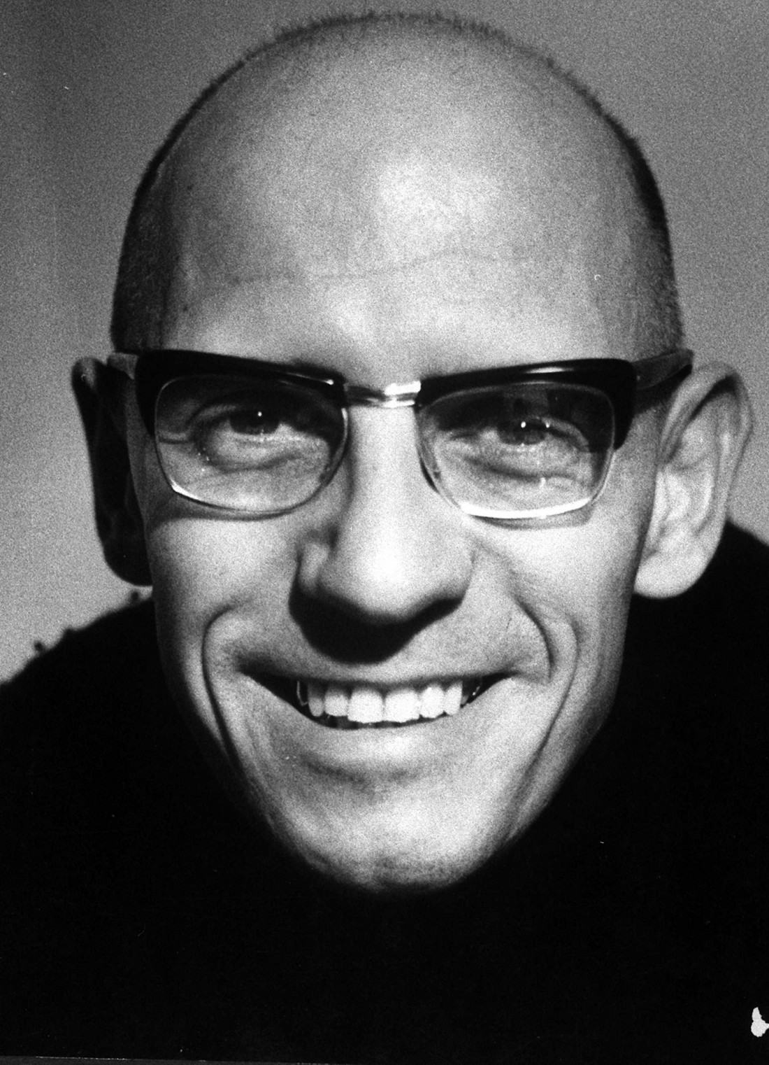
Michel Foucault, 1926-1984

Slide 28
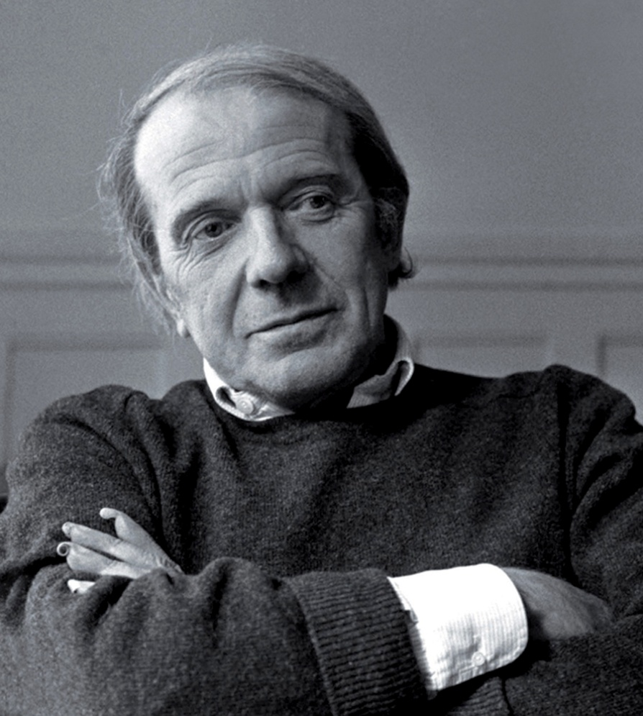
Gilles Deleuze, 1925-1995
literary theory,
post-structuralism,
postmodernism.

Slide 29
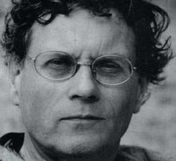
Félix Guattari, 1930-1992

Slide 30
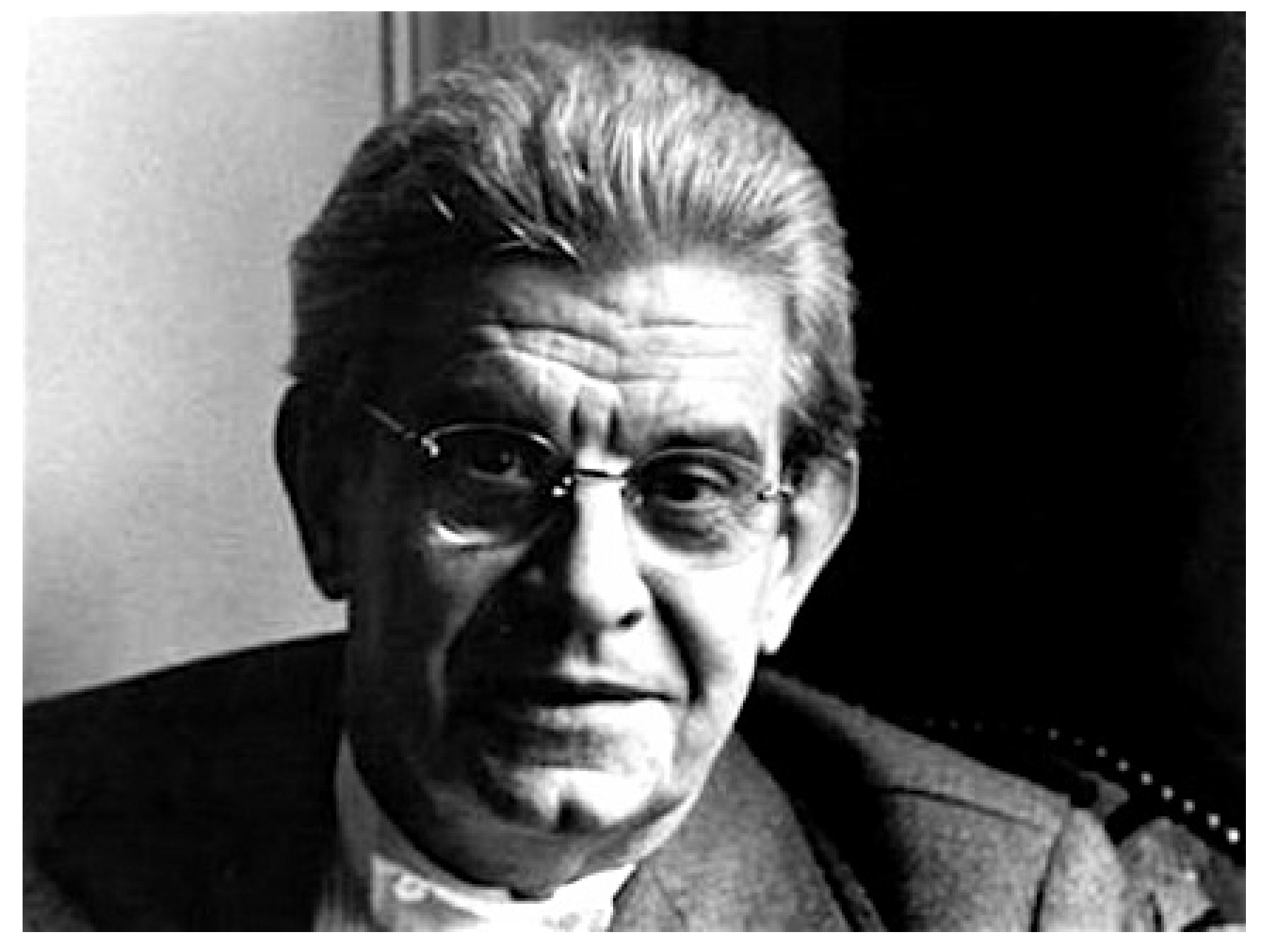
Jacques Lacan, 1901-1981
L'inconscient est structuré comme un langage

Slide 31
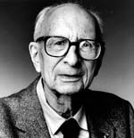
Claude Lévi-Strauss, 1908-2009

Slide 32
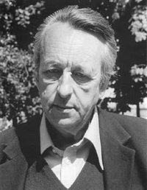
Louis Althusser, 1918-1990

Slide 33
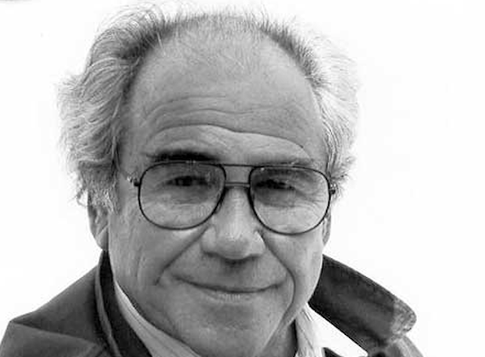
Jean Baudrillard, 1929-2007
postmodernism and specifically post-structuralism

Slide 34
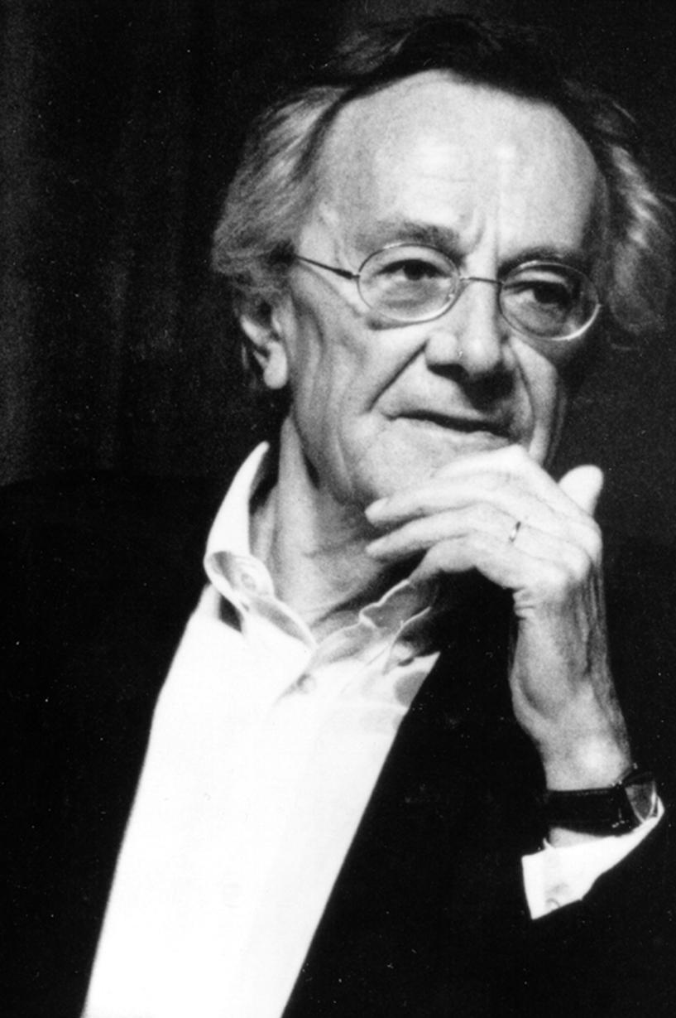
Jean-François Lyotard, 1924-1998

Slide 35
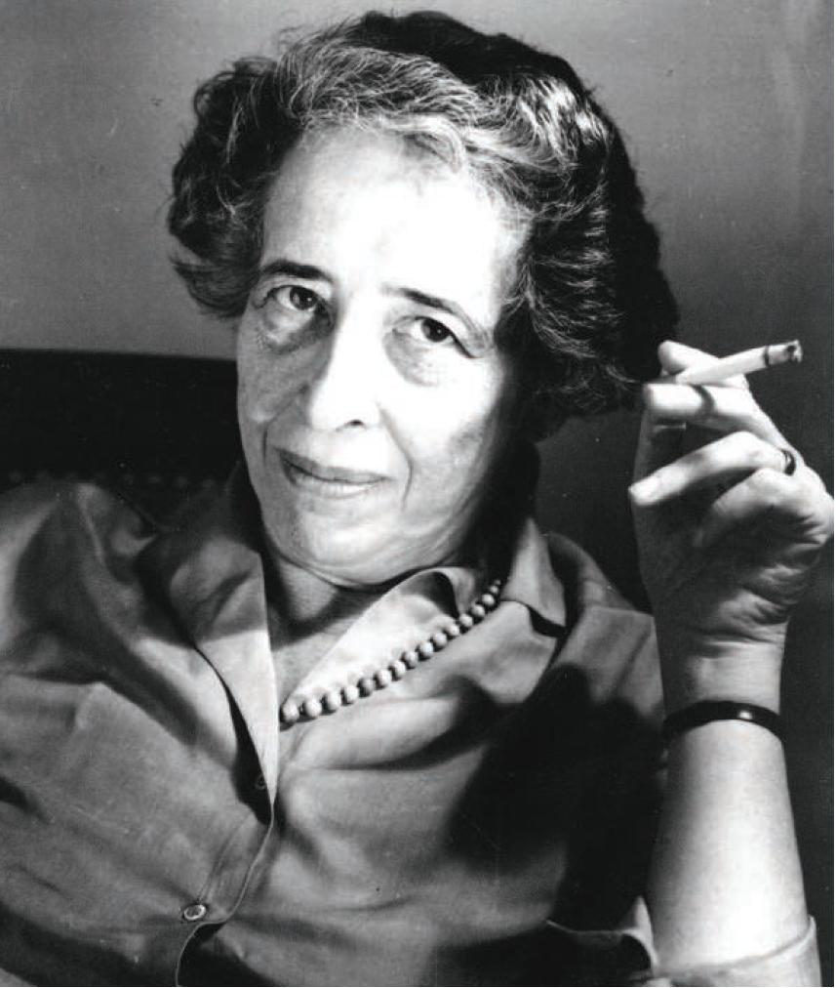
Hannah Arendt, 1906-1975

Slide 36
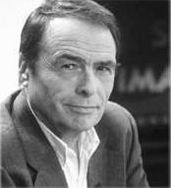
Pierre Bourdieu, 1930-2002

Slide 37
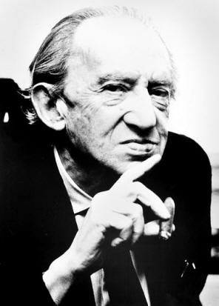
Georg Lukács, 1885-1971

Slide 38
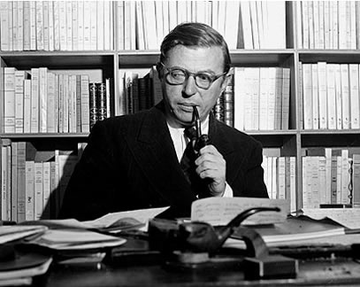
Jean-Paul Sartre, 1905-1980
Existentialism, philosophical thinking begins with the human subject—not merely the thinking subject, but the acting, feeling, living human individual.

Slide 39
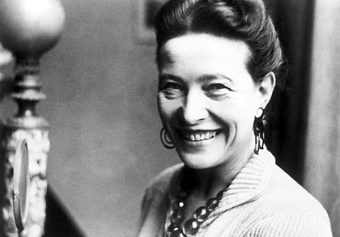
Simone de Beauvoir, 1908-1986

Slide 40
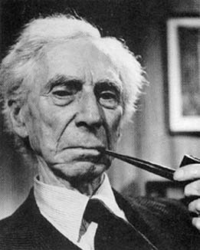
Bertrand Russell, 1872-1970

Slide 41
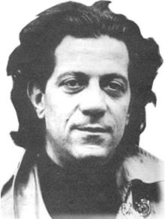
Nicos Poulantzas, 1936-1979

Slide 42
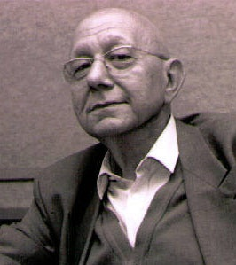
Cornelius Castoriadis, 1922-1997

Slide 43
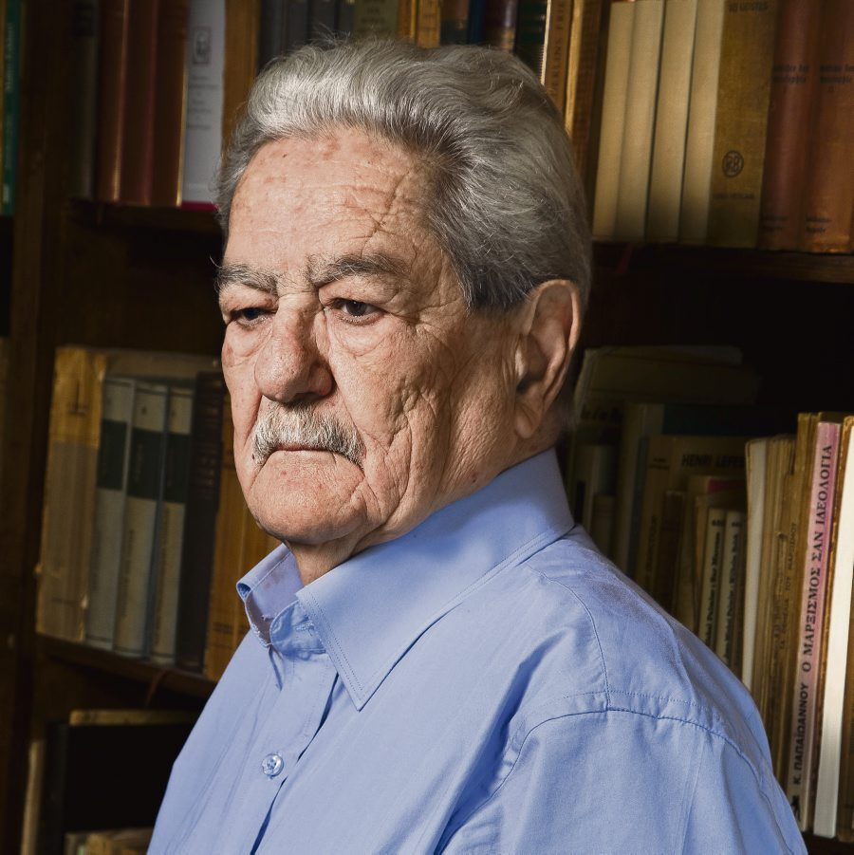
Kostas Axelos, 1924-2010

Slide 44
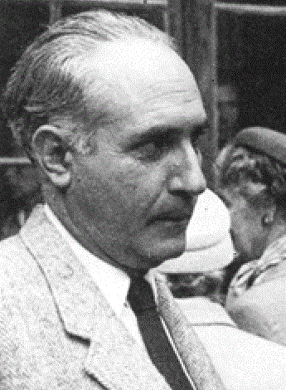
Κωνσταντίνος Θ. Δημαράς, 1904-1992

Slide 45
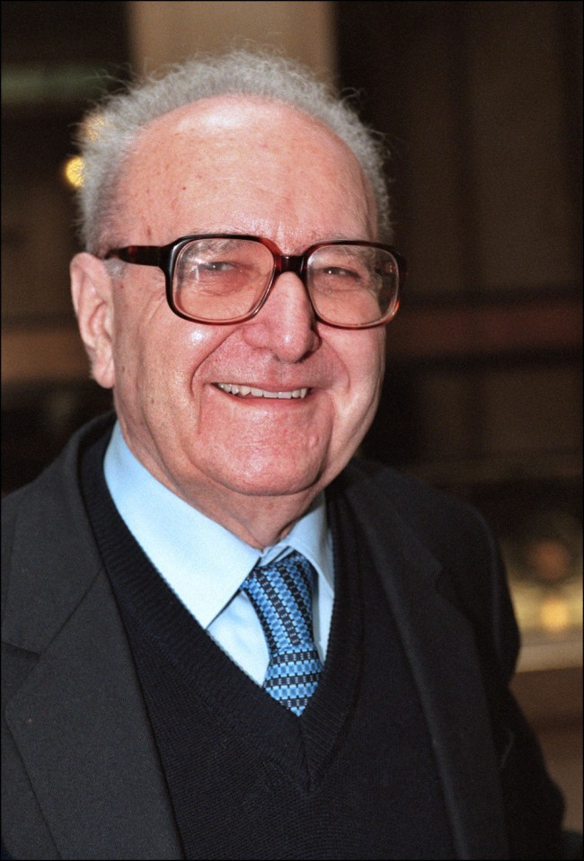
Roger Garaudy, 1913-2012

Slide 46
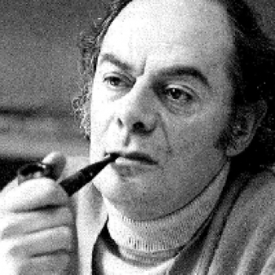
Claude Lefort, 1924-2010

Slide 47
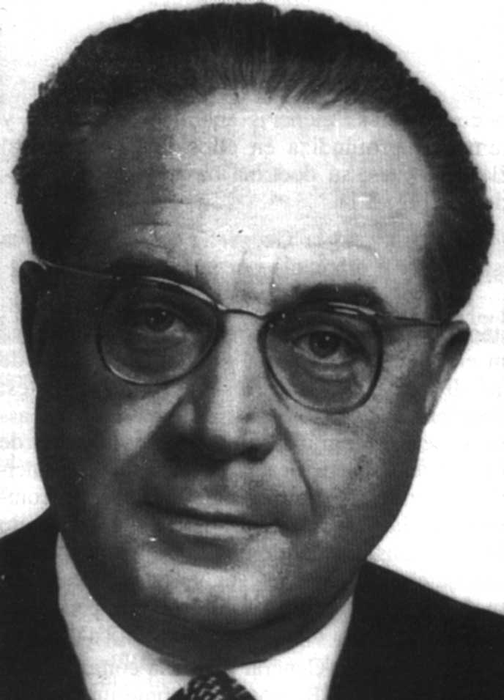
Pierre George, 1909-2006

Slide 48
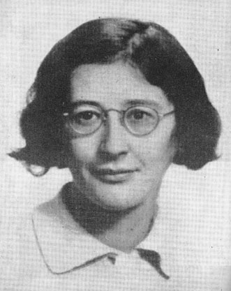
Simone Weil, 1909-1943

Slide 49
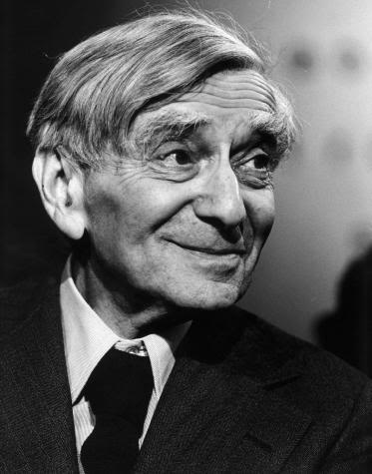
Vladimir Jankélévitch, 1903-1985

Slide 50
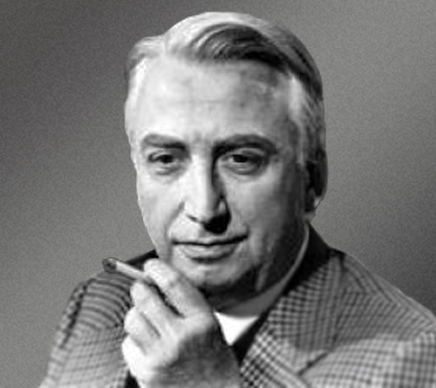
Roland Barthes, 1915-1980
Semiotics, social theory, design theory, anthropology, post-structuralism.
La mort de l’auteur :
Balzac, Sarrasine.

Slide 51
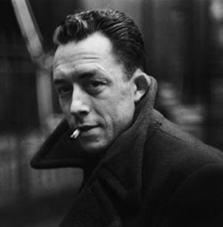
Albert Camus, 1913-1960
The rebel.
Absurdism, the efforts of humanity to find inherent meaning fail (and hence are absurd) because the unknown make certainty impossible. The individuals, conscious of the Absurd, should respond to it, and should embrace the absurd condition of human existence while continuing to search for meaning.

Slide 52
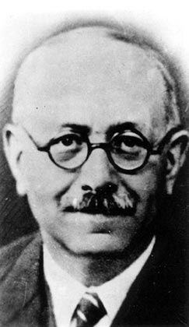
Annales, Marc Bloch, 1886-1944

Slide 53
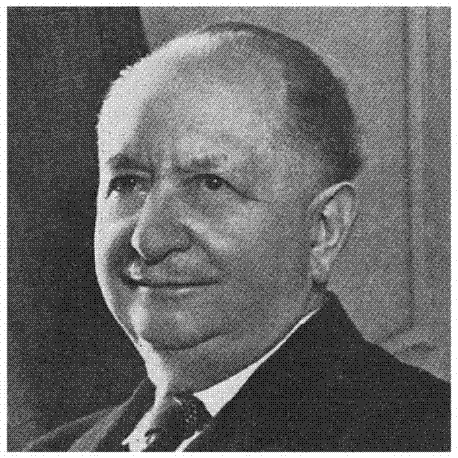
Annales, Lucien Febvre, 1878-1956

Slide 54
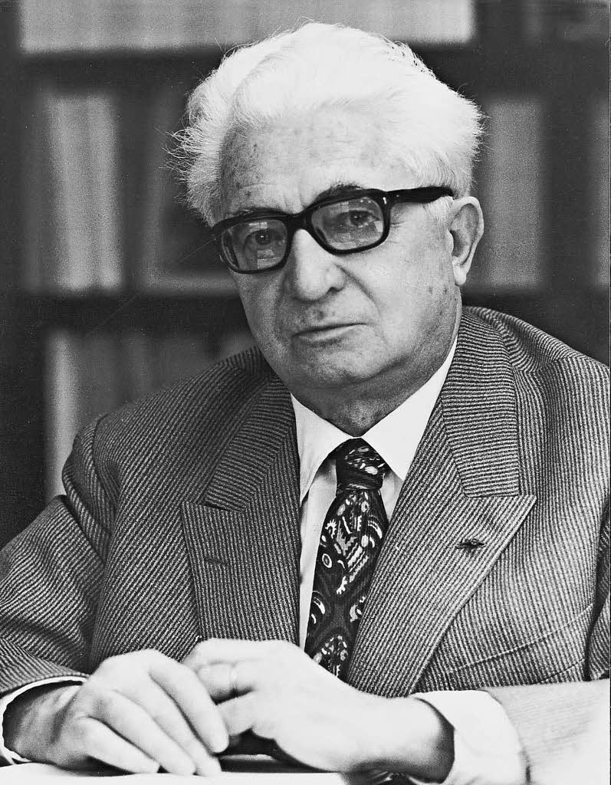
Annales, Fernand Braudel, 1902-1985

Slide 55
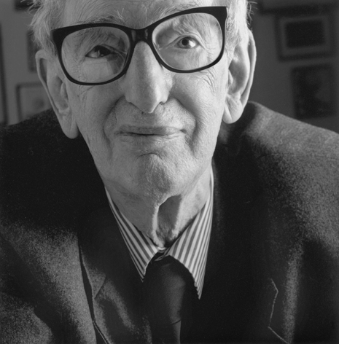
Eric Hobsbawm, 1917-2012

Slide 56
Ralph Miliband, 1924-1994

Slide 57
Ernest Mandel, 1923-1995

Slide 58
Ernesto Laclau, 1935-2014

Slide 59
Michel Wieviorka, born 1946

Slide 60
Anthony Giddens, born 1938

Slide 61
Manuel Castells, born 1942

Slide 62
Immanuel Wallerstein, born 1930

Slide 63
Toni Negri, born 1933

Slide 64
Jacques Rancière, born 1940
co-authored Reading Capital (1968), with the structuralist Marxist philosopher Louis Althusser

Slide 65
Étienne Balibar, born 1942

Slide 66
Edward Saïd, born 1935

Slide 67
Alain Touraine, born 1925

Slide 68
Edgar Morin, born 1921

Slide 69
Georges Labica, born 1930

Slide 70
Noam Chomsky, born 1928

Slide 71
Eftýchios Bitsákis, born 1927

Slide 72
Hélène Glykatzi-Ahrweiler, born 1926

Slide 73
David Harvey, born 1935

Slide 74
Alain Badiou, born 1937

Slide 75
Jürgen Habermas, born 1929

Slide 76
Régis Debray, born 1940

Slide 77
Perry Anderson, 1938

Slide 78
Tony Negri, born 1933

Slide 79
Julia Kristeva, born 1941

Slide 80
Slavoj Žižek, born 1949

Slide 81
Tariq Ali, born 1943

