Slide 1
Humanities & Social Sciences

Slide 2
Frankfurter Schule, school of social theory and philosophy (Goethe University Frankfurt).
Herbert Marcuse
Theodor Adorno
Max Horkheimer
Walter Benjamin
Erich Fromm
Friedrich Pollock
Leo Löwenthal
Jürgen Habermas
Alfred Schmidt
Axel Honneth
Siegfried Kracauer

Slide 3
Critical theory
Dialectic
Praxis
Psychoanalysis
Antipositivism
Popular culture
Culture industry
Advanced capitalism
Privatism
Non-identity
Communicative rationality
Legitimation crisis

Slide 4
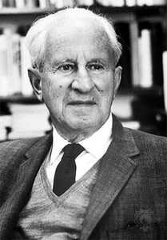
Herbert Marcuse, 1898-1979

Slide 5
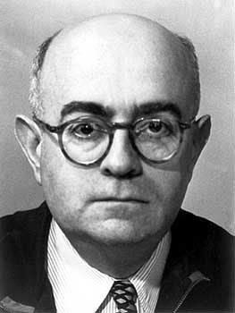
Theodor Adorno, 1903-1969

Slide 6
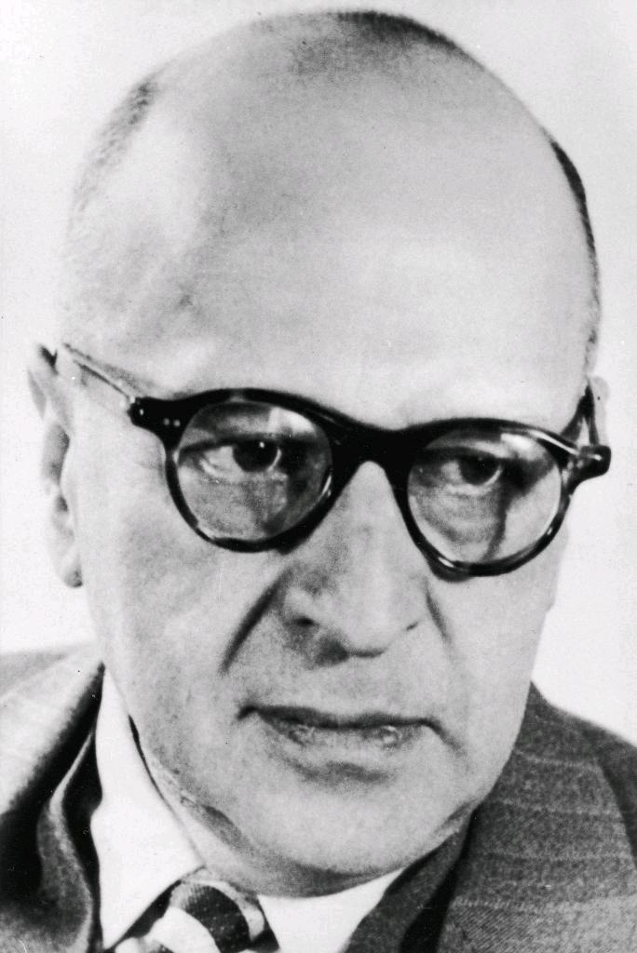
Max Horkheimer, 1895-1973

Slide 7
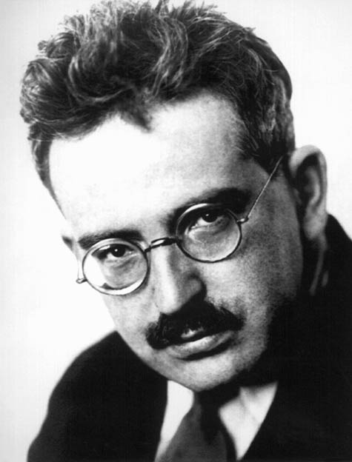
Walter Benjamin, 1892-1940

Slide 8
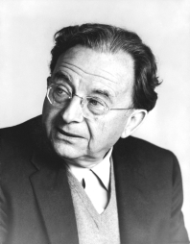
Erich Fromm, 1900 -1980

Slide 9
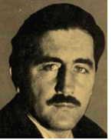
Karl Korsch, 1886-1961

Slide 10
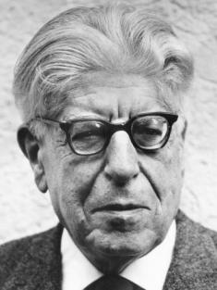
Ernst Bloch, 1885-1977

Slide 11
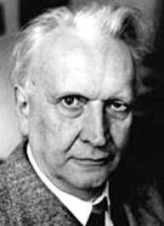
Karl Jaspers, 1883-1969

Slide 12
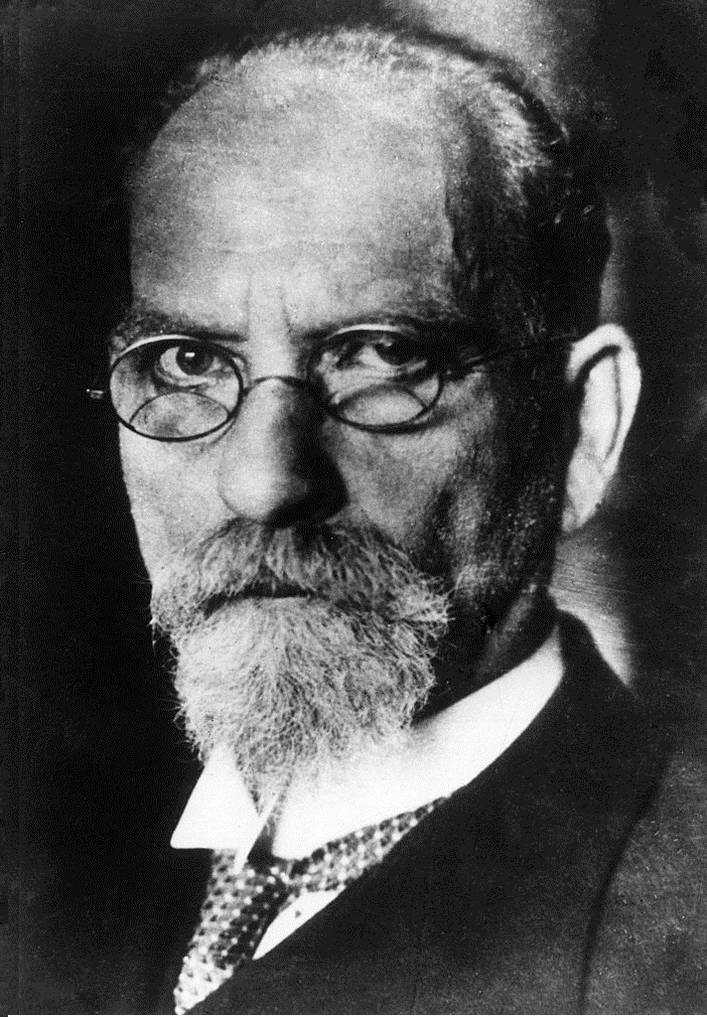
Edmund Husserl, 1859-1938

Slide 13
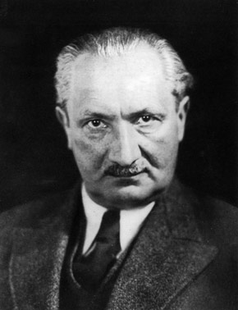
Martin Heidegger, 1889-1976

Slide 14
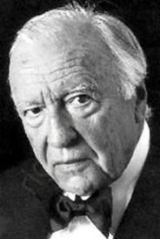
Hans-Georg Gadamer, 1900-2002

Slide 15
philosophers of science

Slide 16
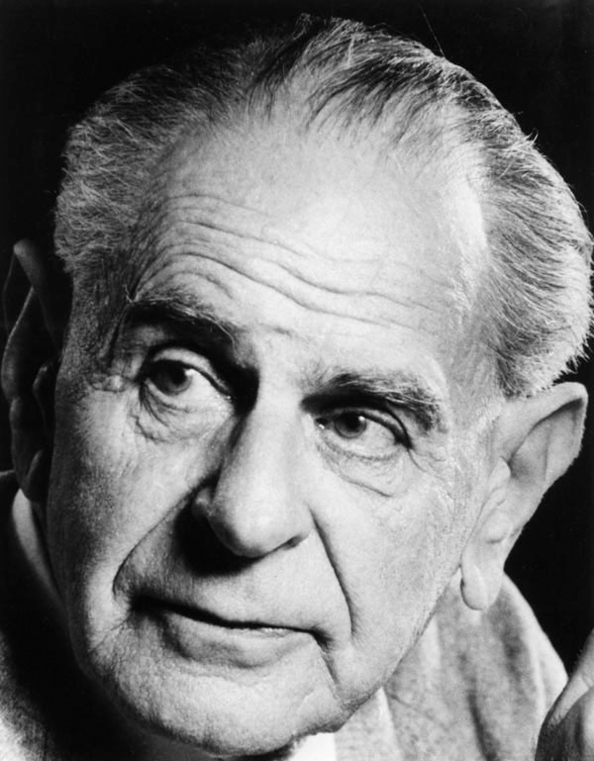
Karl Popper, 1902-1994

Slide 17
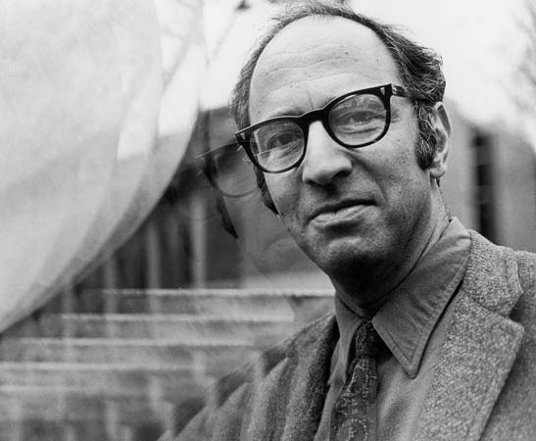
Thomas Kuhn, 1922-1996

Slide 18
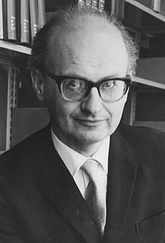
Imre Lakatos, 1922-1974

Slide 19
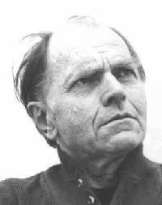
Paul Feyerabend, 1924-1994

Slide 20
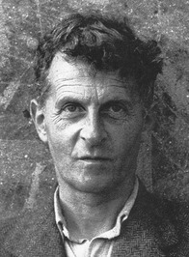
Ludwig Wittgenstein, 1889-1951

Slide 21
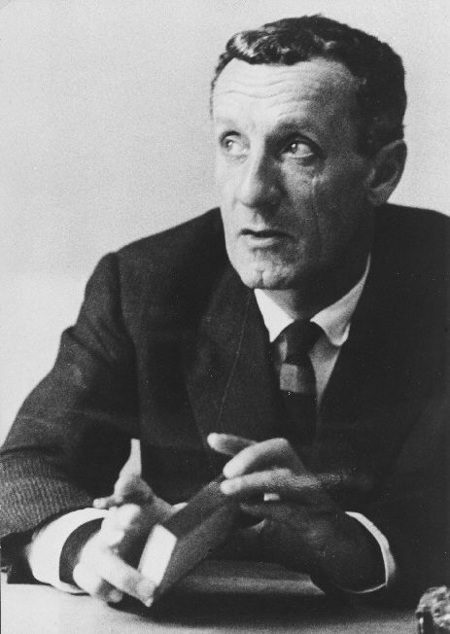
Maurice Merleau-Ponty, 1908-1961

Slide 22
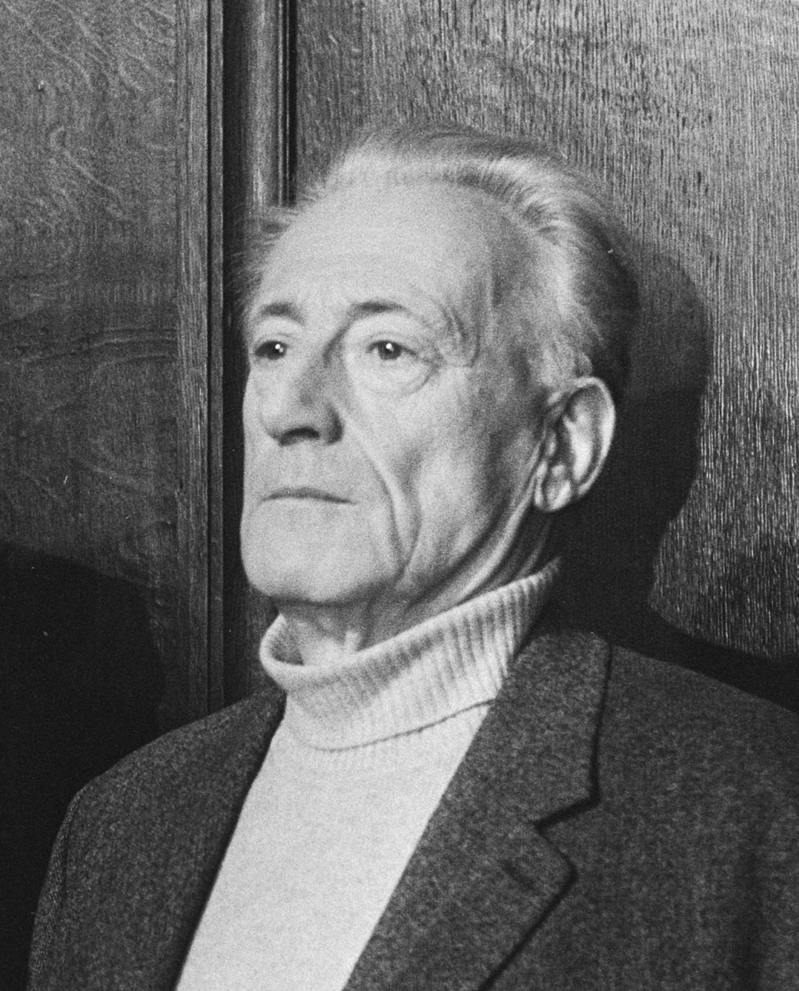
Henri Lefebvre, 1901-1991

Slide 23
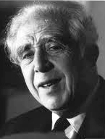
Georges Friedmann, 1902-1977

Slide 24
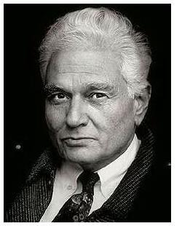
Jacques Derrida, 1930-2004

Slide 25
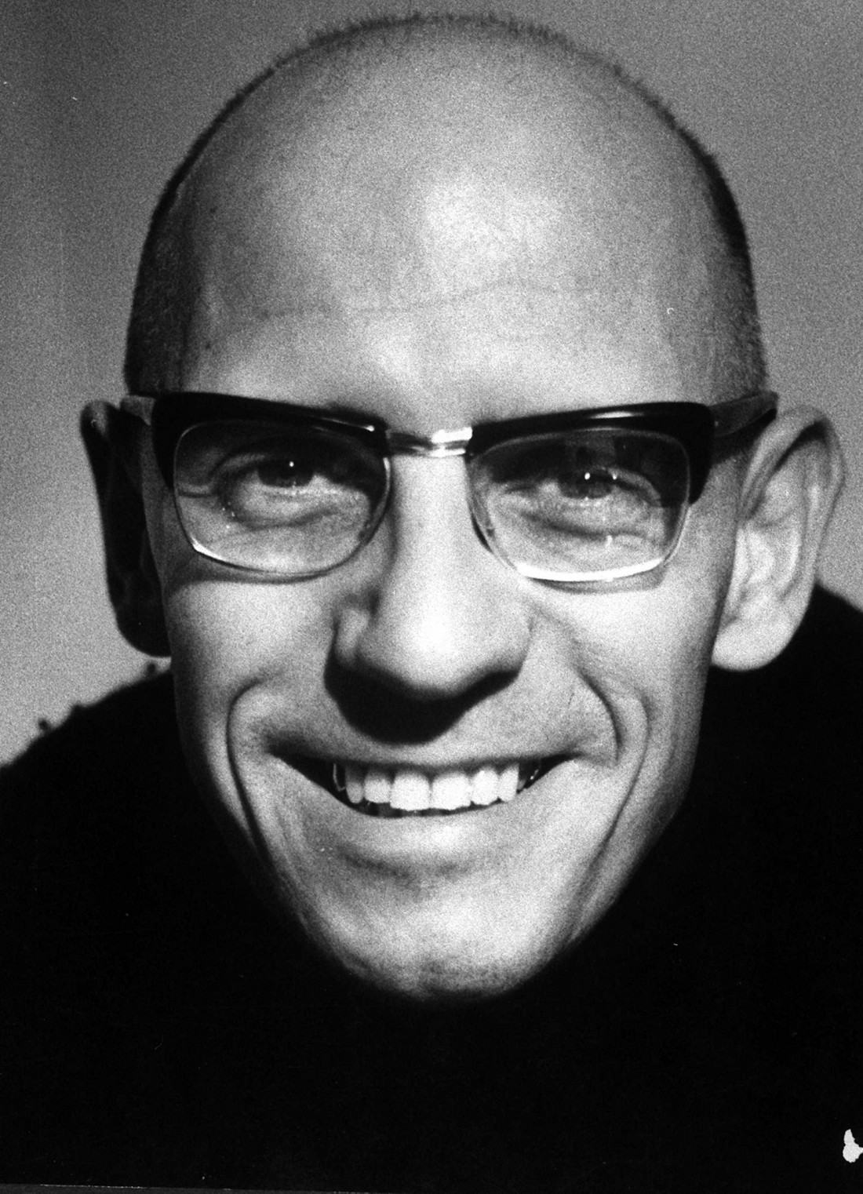
Michel Foucault, 1926-1984

Slide 26
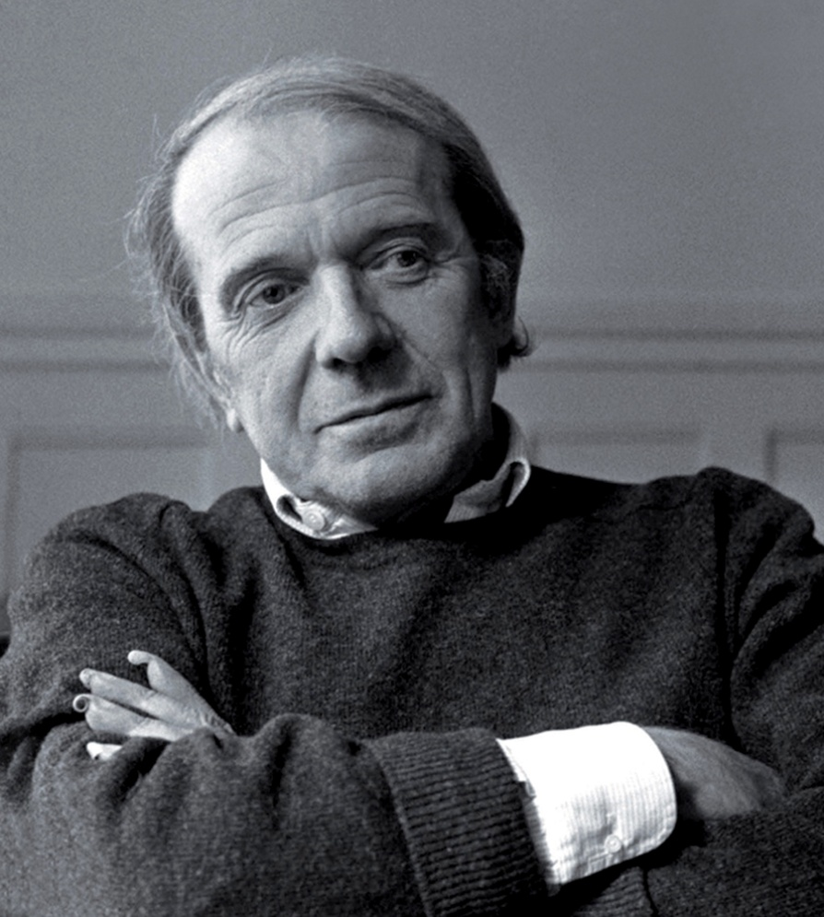
Gilles Deleuze, 1925-1995

Slide 27
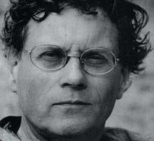
Félix Guattari, 1930-1992

Slide 28
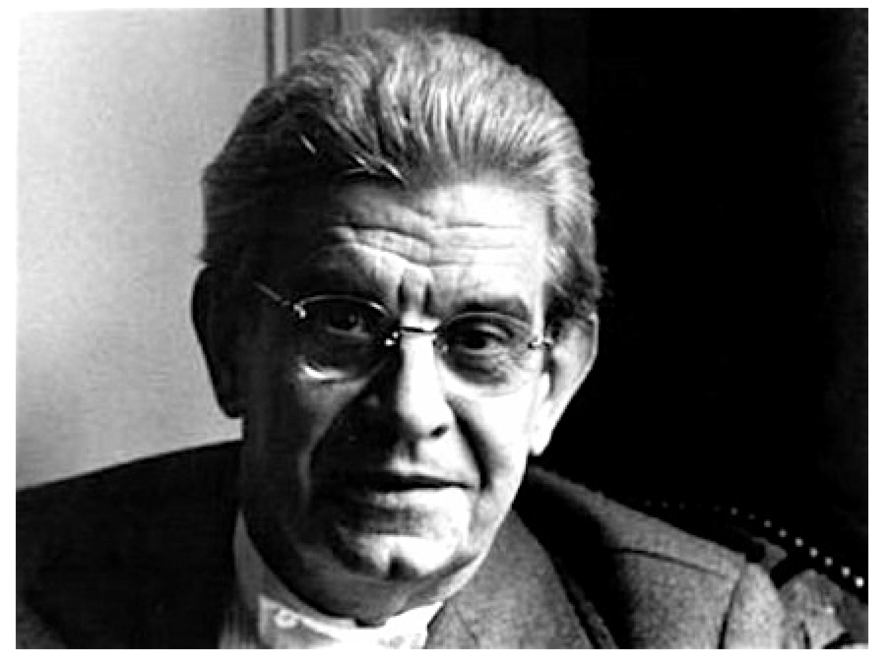
Jacques Lacan, 1901-1981

Slide 29
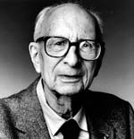
Claude Lévi-Strauss, 1908-2009

Slide 30
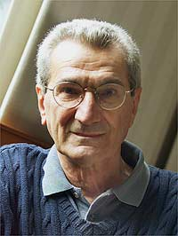
Toni Negri, born 1933

Slide 31
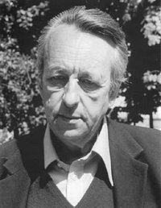
Louis Althusser, 1918-1990

Slide 32
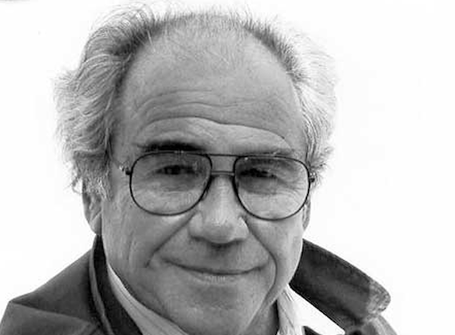
Jean Baudrillard, 1929-2007

Slide 33
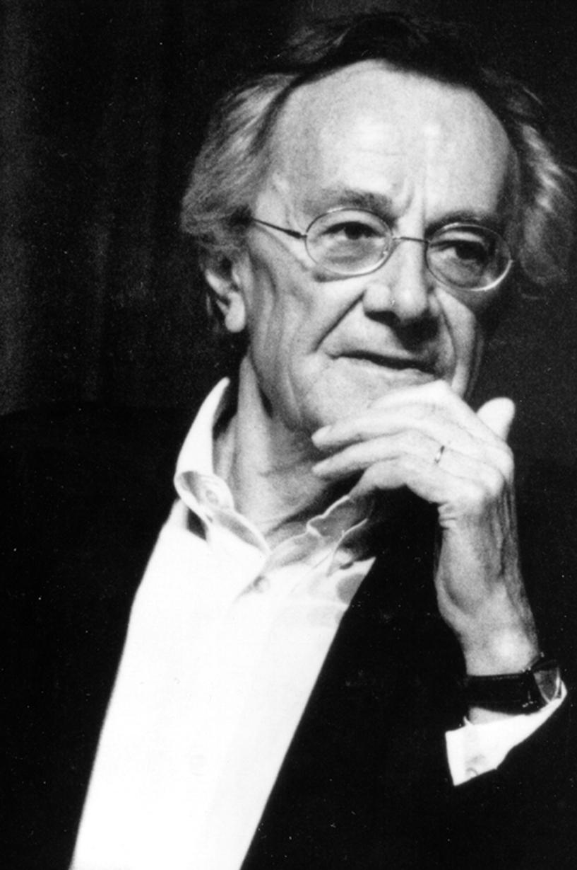
Jean-François Lyotard, 1924-1998

Slide 34
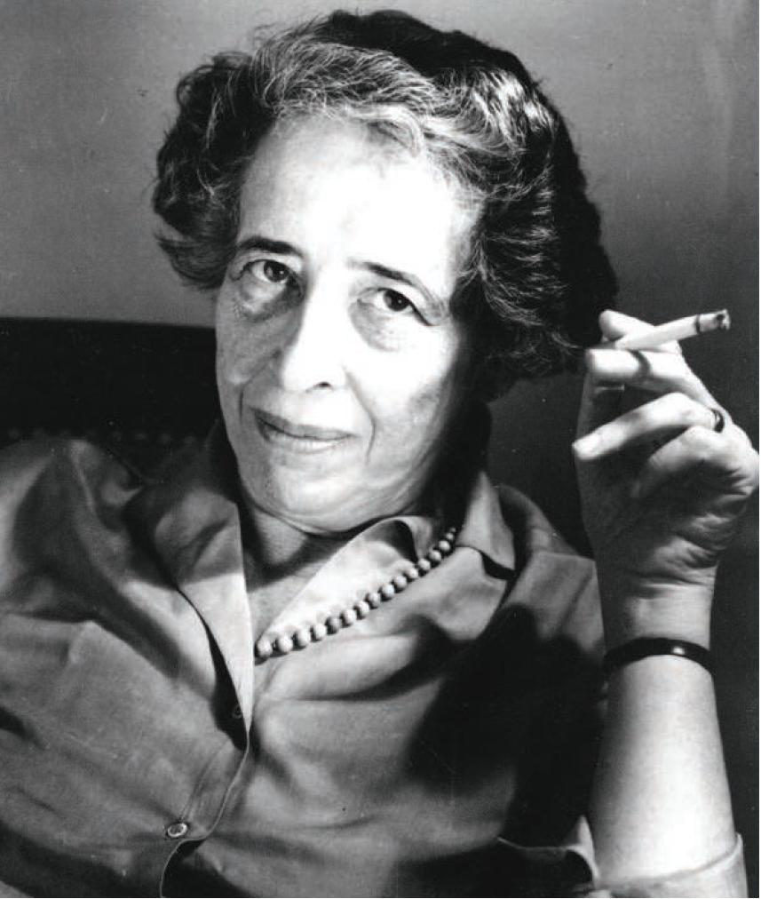
Hannah Arendt, 1906-1975

Slide 35
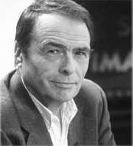
Pierre Bourdieu, 1930- 2002

Slide 36
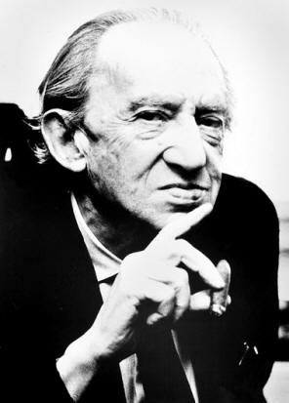
Georg Lukács, 1885-1971

Slide 37
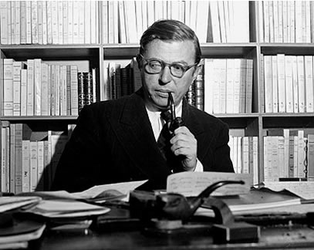
Jean-Paul Sartre, 1905-1980

Slide 38
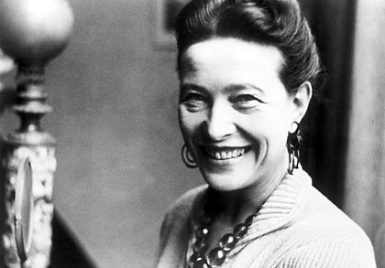
Simone de Beauvoir, 1908-1986

Slide 39
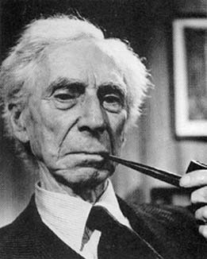
Bertrand Russell, 1872-1970

Slide 40
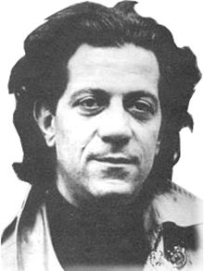
Nicos Poulantzas 1936-1979

Slide 41
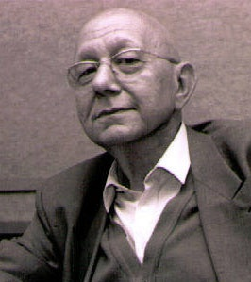
Cornelius Castoriadis, 1922-1997

Slide 42
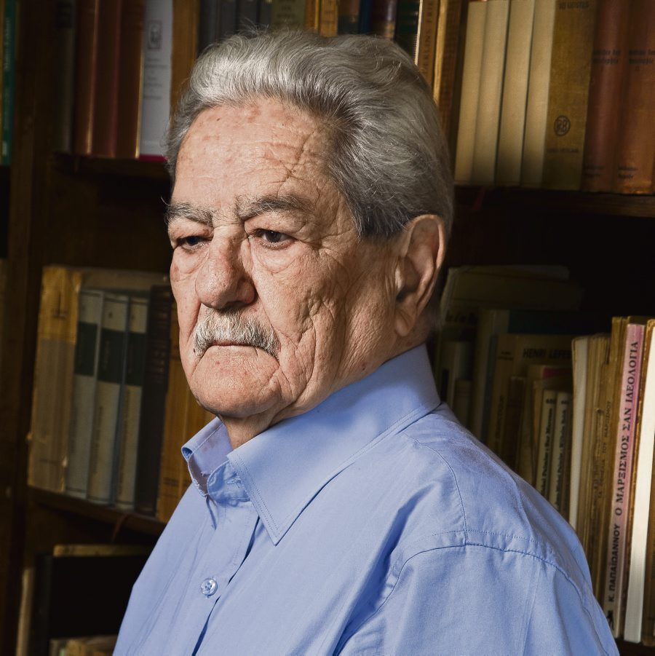
Kostas Axelos, 1924-2010

Slide 43
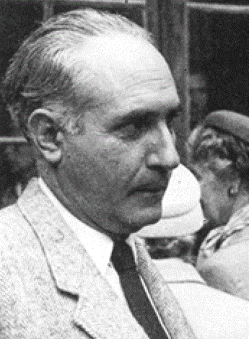
Κωνσταντίνος Θ. Δημαράς, 1904-1992

Slide 44
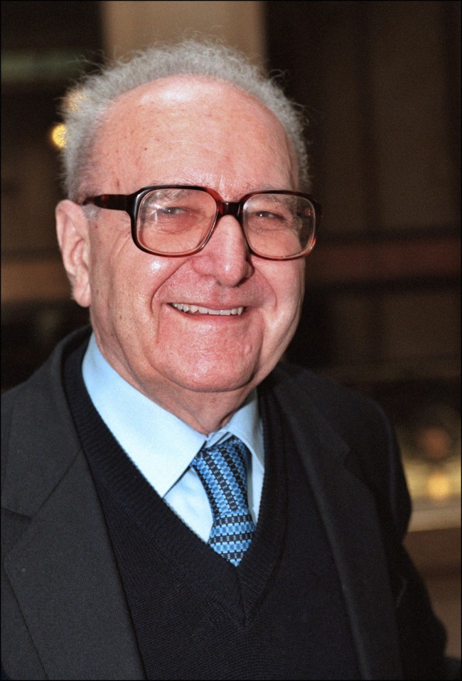
Roger Garaudy, 1913-2012

Slide 45
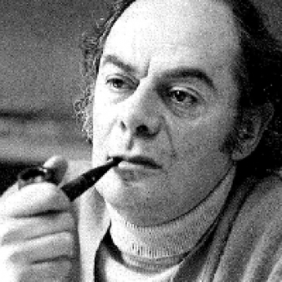
Claude Lefort, 1924-2010

Slide 46
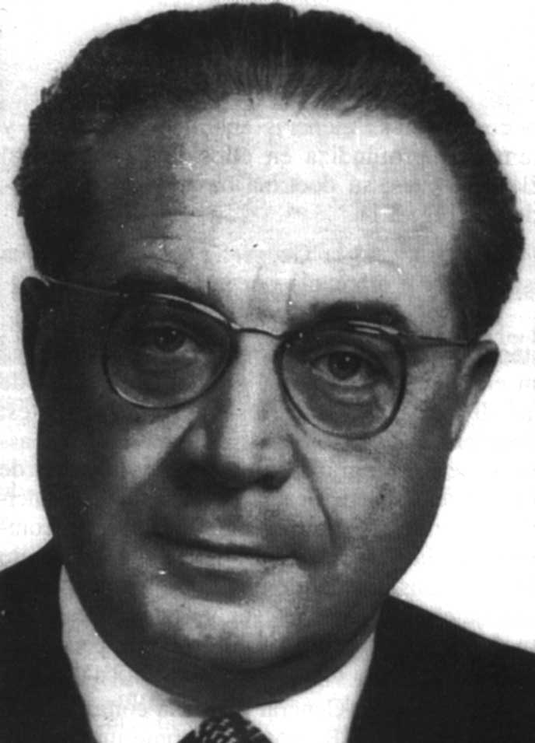
Pierre George, 1909-2006

Slide 47
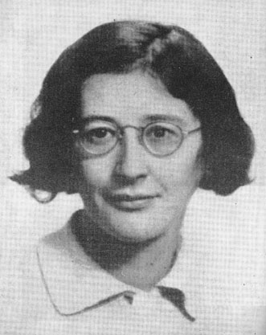
Simone Weil, 1909-1943

Slide 48
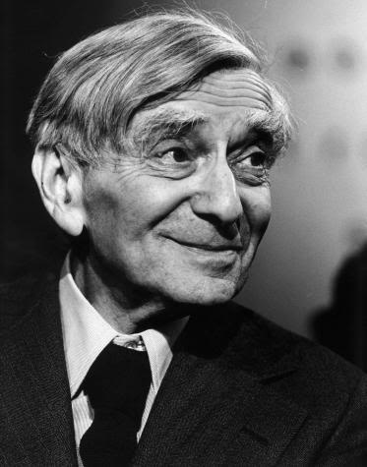
Vladimir Jankélévitch, 1903-1985

Slide 49
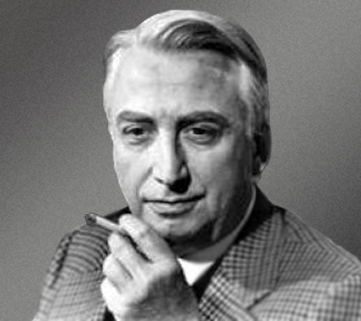
Roland Barthes, 1915-1980

Slide 50
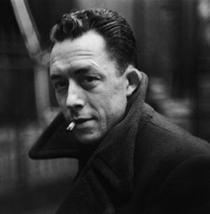
Albert Camus, 1913-1960

Slide 51
επιθεώρηση Annales

Slide 52
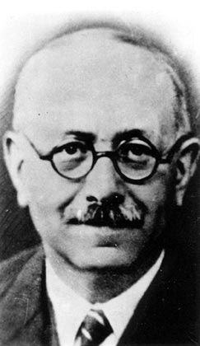
Marc Bloch, 1886-1944

Slide 53
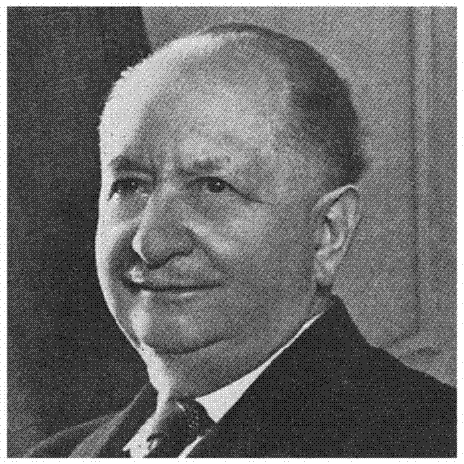
Lucien Febvre, 1878-1956

Slide 54
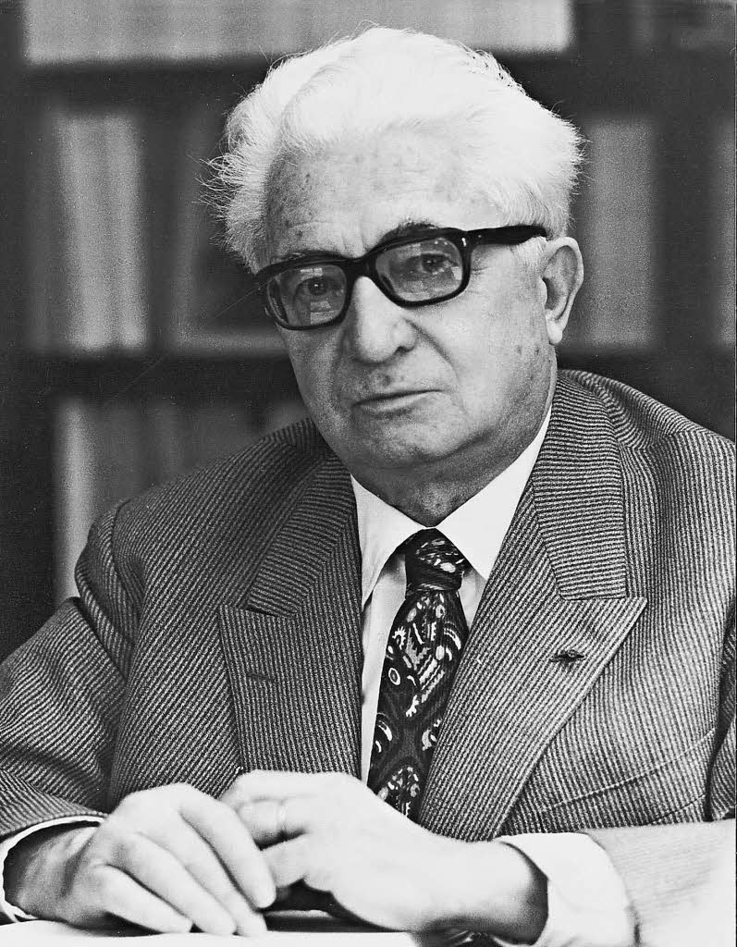
Fernand Braudel, 1902-1985

Slide 55
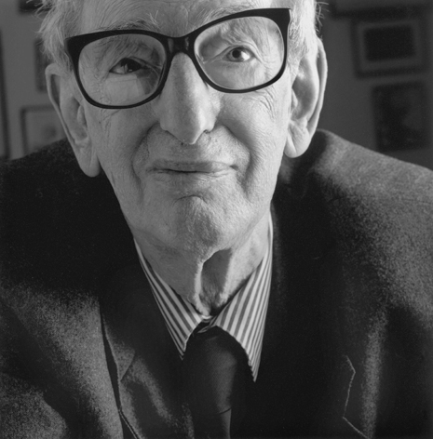
Eric Hobsbawm, 1917-2012

Slide 56
Ralph Miliband, 1924-1994

Slide 57
Ernest Mandel, 1923-1995

Slide 58
Ernesto Laclau, 1935-2014

Slide 59
Michel Wieviorka, born 1946

Slide 60
Anthony Giddens, born 1938

Slide 61
Manuel Castells, born 1942

Slide 62
Immanuel Wallerstein, born 1930

Slide 63
Jacques Rancière, born 1940

Slide 64
Étienne Balibar, born 1942

Slide 65
Edward Saïd, born 1935

Slide 66
Alain Touraine, born 1925

Slide 67
Edgar Morin, born 1921

Slide 68
Georges Labica, born 1930

Slide 69
Noam Chomsky, born 1928

Slide 70
Eftýchios Bitsákis, born 1927

Slide 71
Hélène Glykatzi-Ahrweiler, born 1926

Slide 72
David Harvey, born 1935

Slide 73
Alain Badiou, born 1937

Slide 74
Jürgen Habermas, born 1929

Slide 75
Samir Amin, born 1931

Slide 76
Perry Anderson, 1938

Slide 77
Julia Kristeva, born 1941

Slide 78
Slavoj Žižek, born 1949

